Slide 2
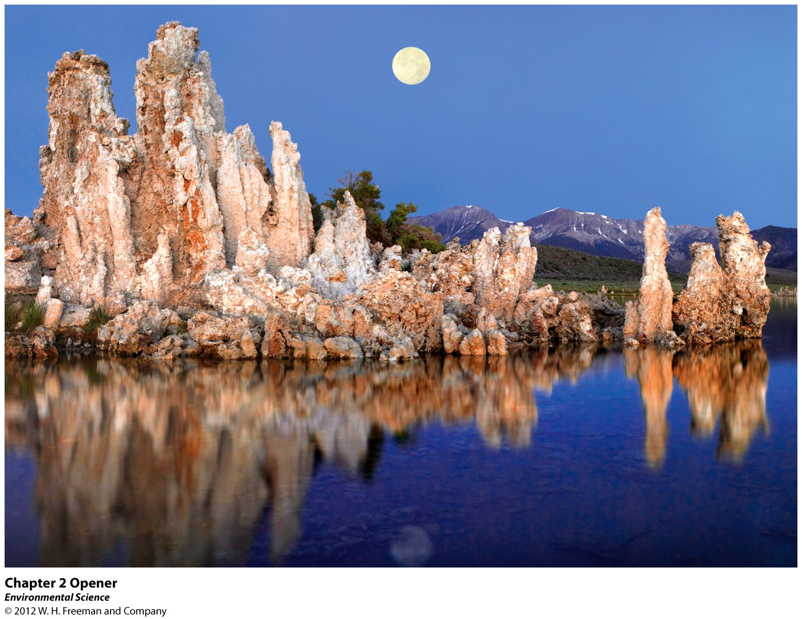
Chapter 2
Environmental Systems

Slide 3
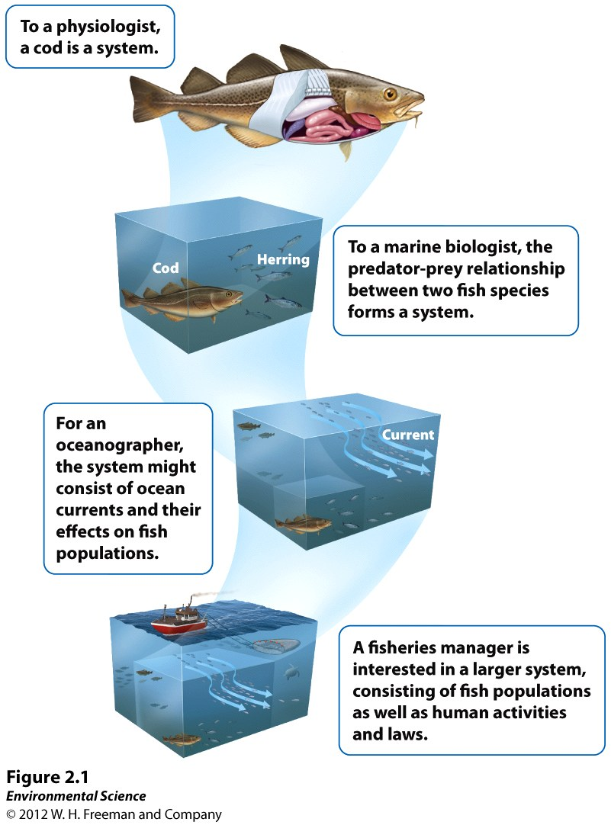
Earth is a single interconnected system
All environmental systems consist of matter
What are the basic building blocks of matter?

Slide 4
Matter- anything that occupies space and has mass.
Mass- a measure of the amount of matter an object contains.
Weight- the force that results from the action of gravity on mass.

Slide 5
Atoms and Molecules
Atom- the smallest particle that can contain the chemical properties of an element.
Element- a substance composed of atoms that cannot be broken down into smaller, simpler components. Elements can be solid, liquid or gas.
Periodic Table- lists all the elements currently known.
Molecules- particles containing more than one atom.

Slide 6
Atoms and Molecules
Compounds- molecules that contain more than one element.
Atomic Number- the number of protons in the nucleus of a particular element.
Mass Number- the total number of protons and neutrons in an element.
Isotopes- atoms of the same element that have different numbers of neutrons, and therefore different atomic masses.

Slide 7
Structure of an atom
Examples of isotopes:
Atomic number- 6
Atomic mass -12

Slide 8
Radioactivity
Radioactive decay- the spontaneous release of material from the nucleus of an unstable isotope.
Radioactive decay changes the radioactive element into a different element. i.e. Uranium-235 decays to form Thorium-231.
Uranium is called the parent and thorium the daughter.

Slide 9
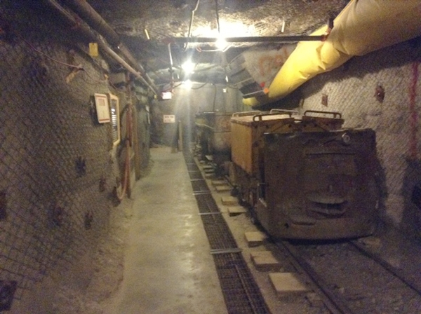
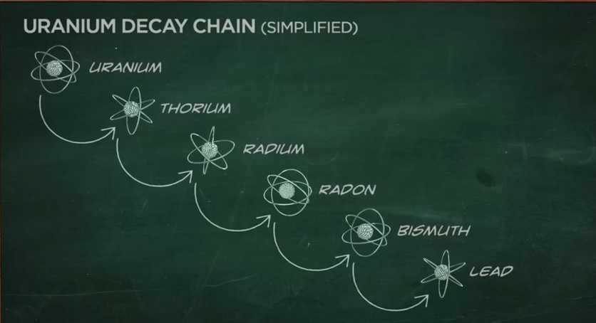
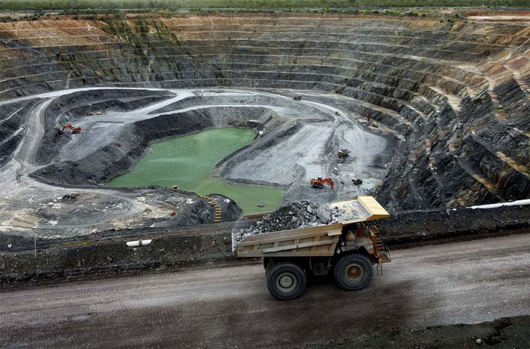

Slide 10
Radioactivity
Half-life- the time it takes for one-half of the original radioactive parent atoms to decay.
Some elements that undergo radioactive decay emit harmful radiation.
Knowledge of the half-life allows scientists to determine the length of time that a radioactive element may be dangerous.
https://www.youtube.com/watch?v=js7weHZIQ5o

Slide 11
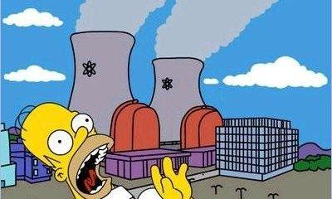
Nuclear Energy
Atoms make up everything
Fission is the splitting of the atom releasing neutrons generating energy
That energy can boil water to create steam, which in turn causes turbines to spin, generating electricity in a power plant.

Slide 12
Yucca Mountain

Slide 13
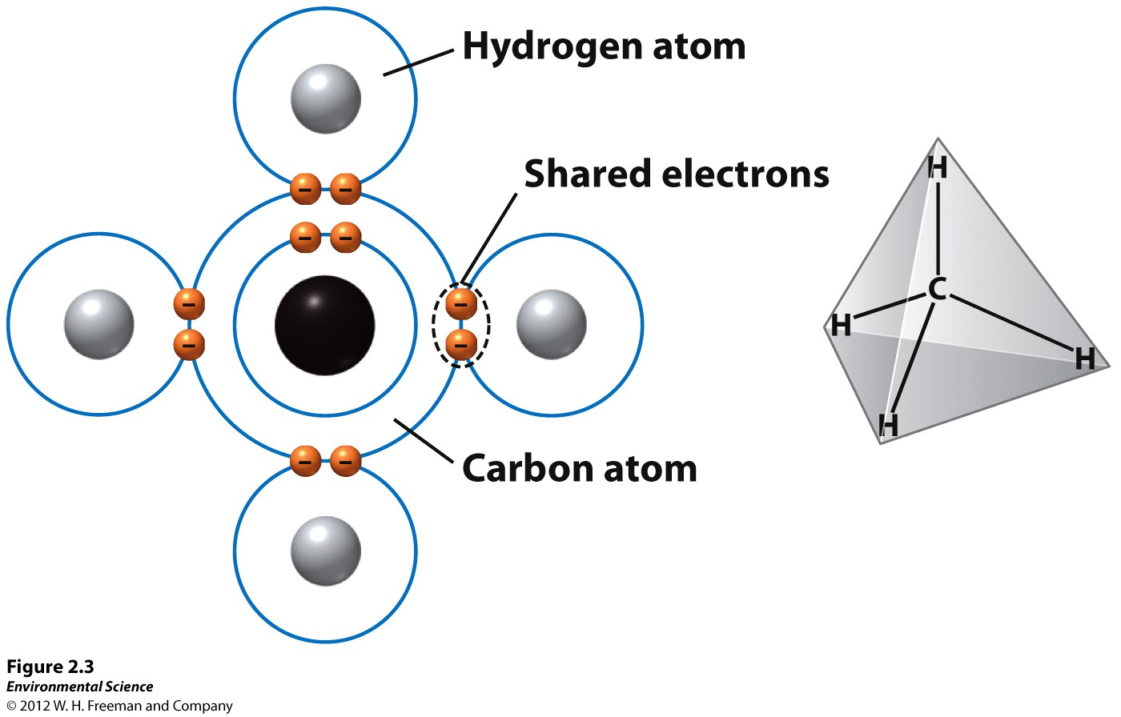
Chemical bonds
Covalent bonds- elements that form compounds by sharing electrons.

Slide 14
Chemical bonds
Ionic bonds- elements that form compounds by transferring electrons from one element to another.
When this transfer happens, one atom becomes electron deficient (positively charged) and one atom becomes electron rich (negatively charged)

Slide 15
Chemical bonds
Hydrogen bonds- a weak chemical bond that forms when hydrogen atoms that are covalently bonded to one atom are attracted to another atom on another molecule.
Water is known as a polar molecule, one side is more positive and the other side is more negative.

Slide 16
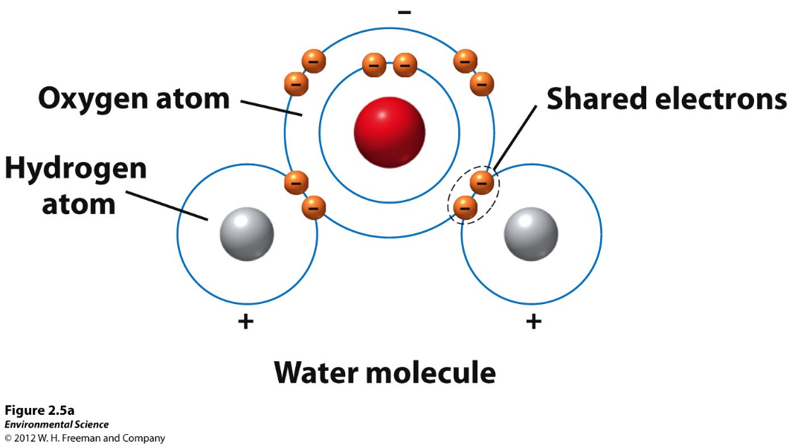
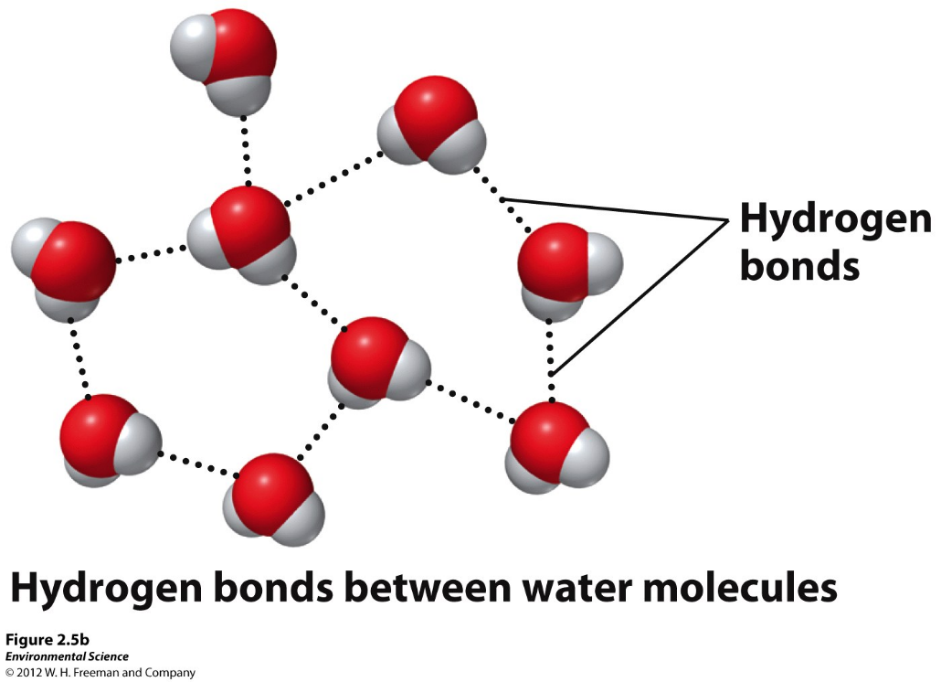
Chemical bonds

Slide 17
Properties of water
Surface tension- the result from the cohesion of water molecules at the surface of a body of water.
Capillary action- when adhesion of water molecules to a surface is stronger than cohesion between the molecules.

Slide 18
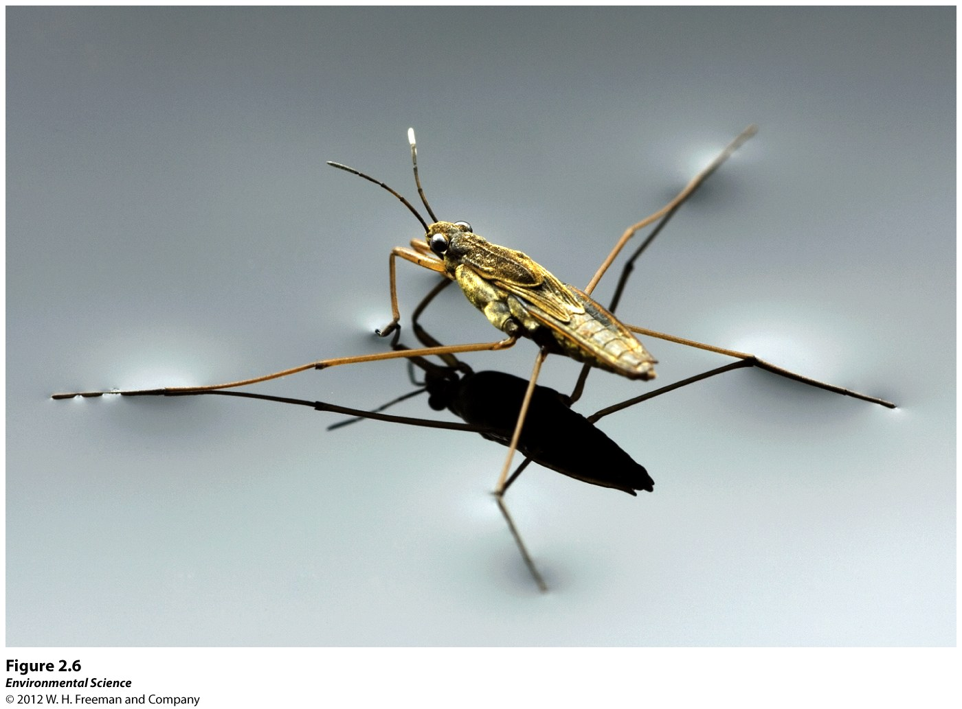

Slide 19
Properties of water
Boiling and freezing- at Earth’s surface, water boils at 100 degrees celsius and freezes at 0 degrees celsius.
Water as a solvent- many substances dissolve well in water because their polar molecules bond easily with other polar molecules.

Slide 20
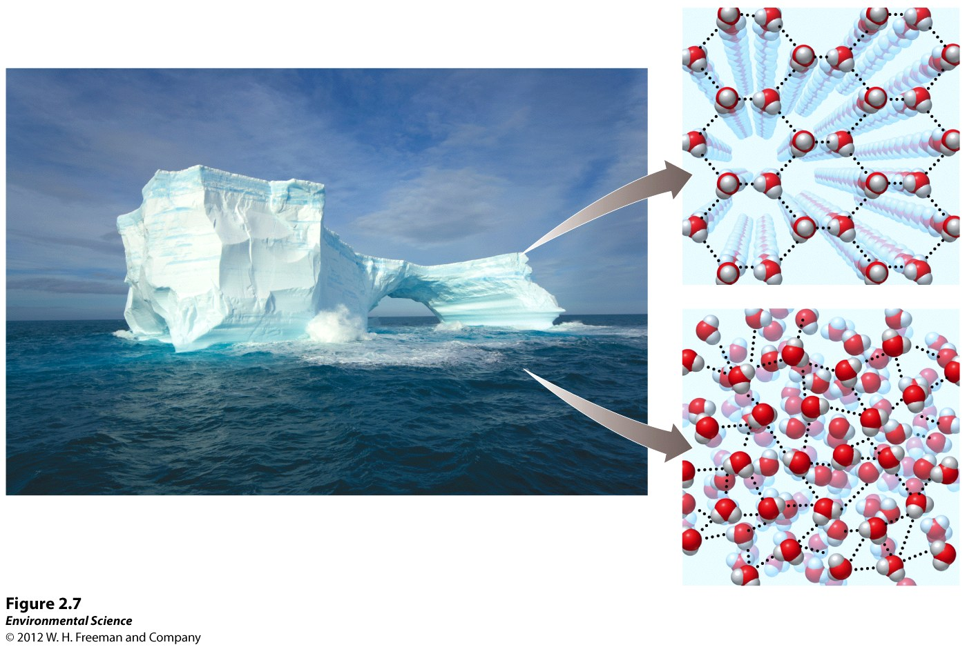
Properties of water

Slide 21
acids, bases, and pH
Acid- a substance that contributes hydrogen ions to a solution.
Base- a substance that contributes hydroxide ions to a solution.

Slide 22
