Slide 1
Energy
Earth’s systems cannot function, and organisms cannot survive, without energy
When energy is transformed, the quantity of energy remains the same, but its ability to do work diminishes
Individual organisms rely on a continuous input of energy in order to survive, grow and reproduce

Slide 2
Forms of Energy
Energy- the ability to do work.
Power- the rate at which work is done.
energy = power X time

Slide 3
Forms of Energy
Kinetic energy- energy of motion.
Potential energy- energy that is stored.
Chemical energy- potential stored in chemical bonds.
Temperature- the measure of the average kinetic energy of a substance.

Slide 4
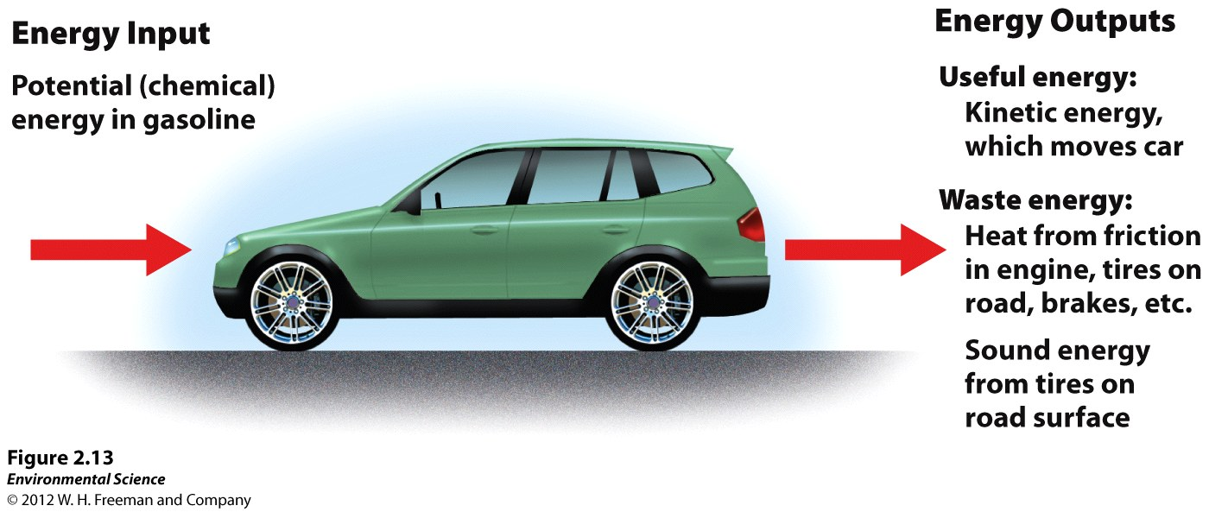
First law of thermodynamics
Energy is neither created or destroyed.
You can’t get something from nothing.

Slide 5
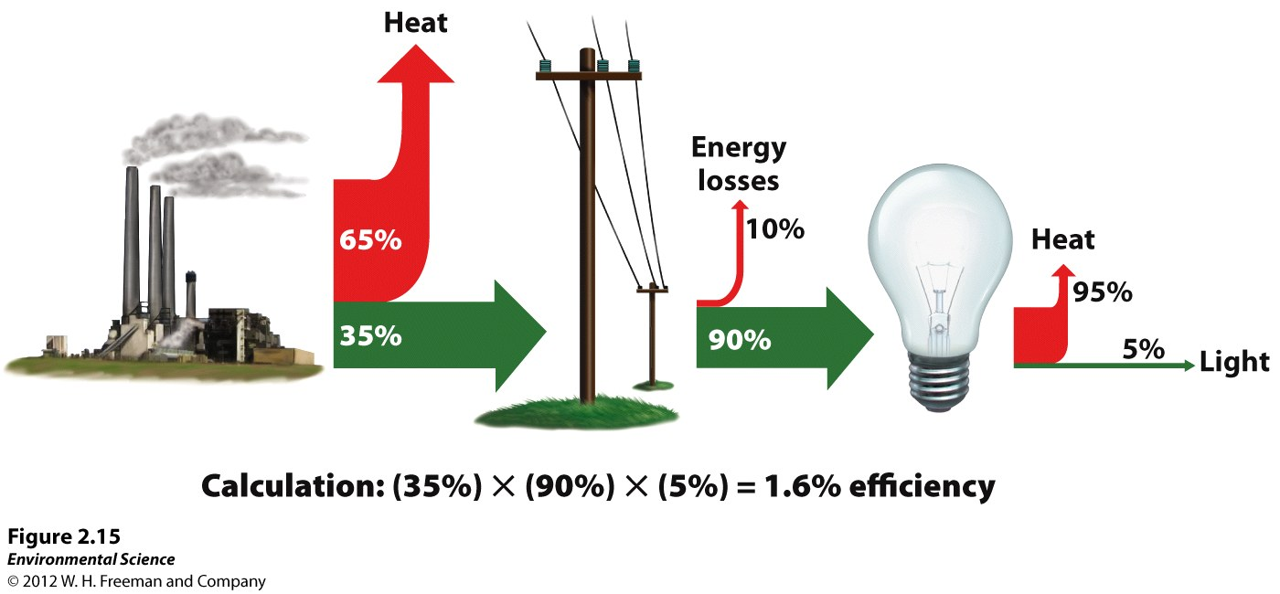
Second law of thermodynamics
When energy is transformed, the quantity of energy remains the same, but its ability to do work diminishes.
Figure 2.15

Slide 6
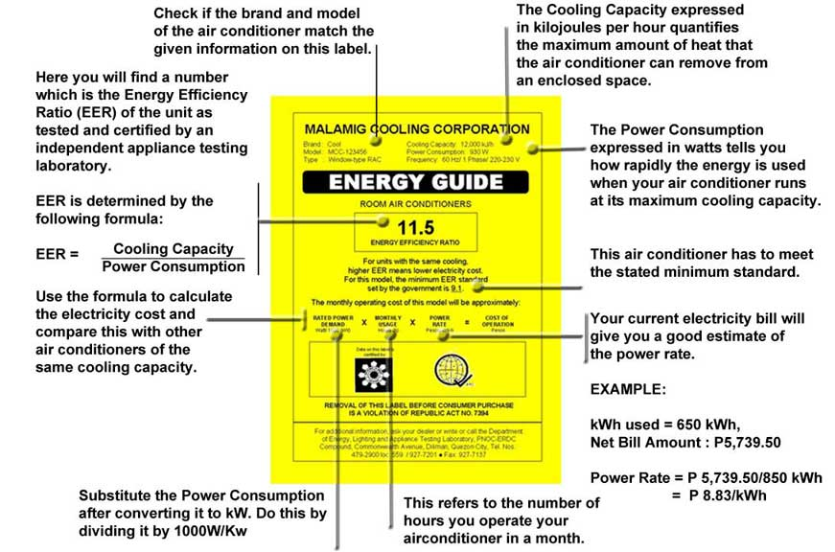
Second law of thermodynamics
Energy Efficiency- the ratio of the amount of work that is done to the total amount of energy that is introduced into the system.

Slide 7
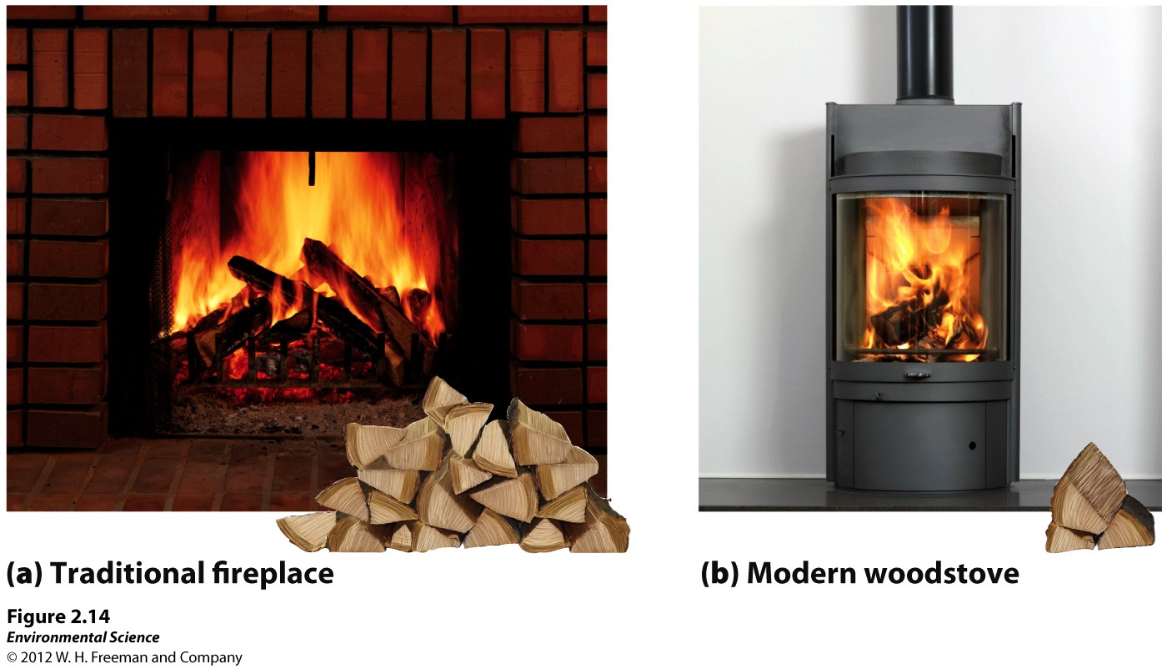
Efficiency:
Wood fireplace is 10% using 31# of wood
Woodstove is 70% using about 4.5 # of wood
Figure 2.14

Slide 8
Energy Sustainability
Type of vehicle?
Place you want to visit in the US of A
Calculate amount of gasoline that would be needed in your vehicle to take the trip.
Cost?

Slide 9
Second law of thermodynamics
Energy quality- the ease with which an energy source can be used for work.
Entropy- all systems move toward randomness rather than toward order.
This randomness is always increasing in a system, unless new energy from the outside of the system is added to create order.

Slide 11
Energy conversions underlie all ecological processes
The amount of available energy determines which organisms can live in a natural system
Life requires order.
Individual organisms rely on a continuous input of energy in order to survive, grow, and reproduce.
The form and amount of energy available in an environment determines what kinds of organisms can live there.

Slide 12
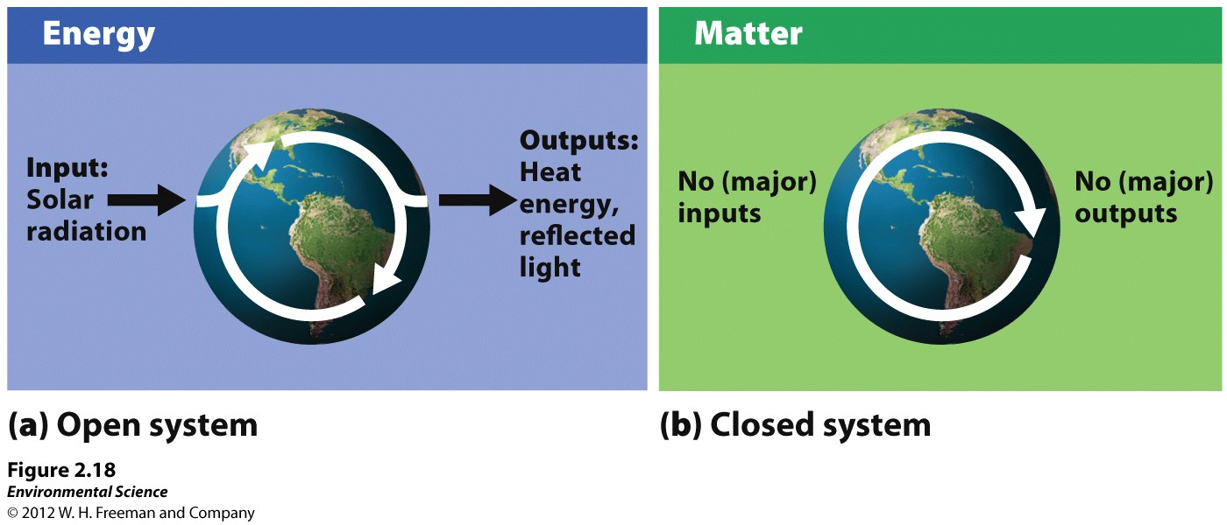
System analysis shows how matter and energy flow in the environment
Open system- exchanges of matter or energy occur across system boundaries.
Closed system- matter and energy exchanges across system boundaries do not occur.

Slide 13
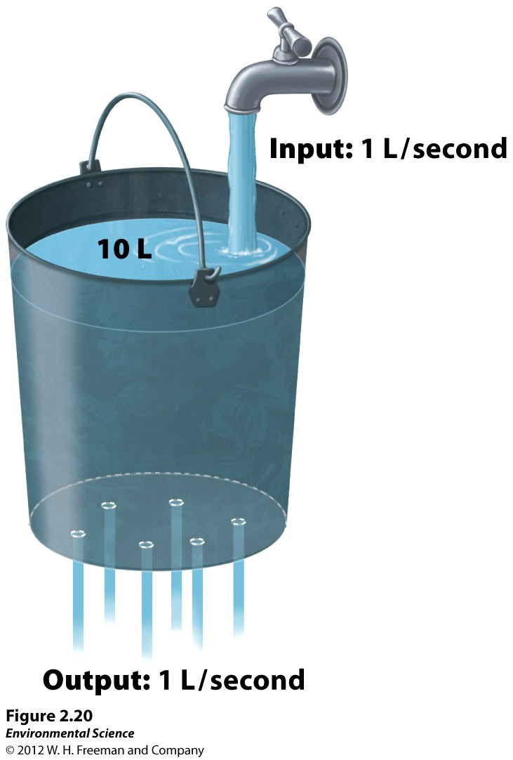
steady states
Steady state- in a system, when input equals output it is said to be in a steady state.

Slide 14
steady states
Negative feedback loops- when a system responds to change by returning to its original state, or at least by decreasing the rate at which the change is occurring.
Positive feedback loops- when a system responds to change by increasing the rate at which the change is occurring.

Slide 15
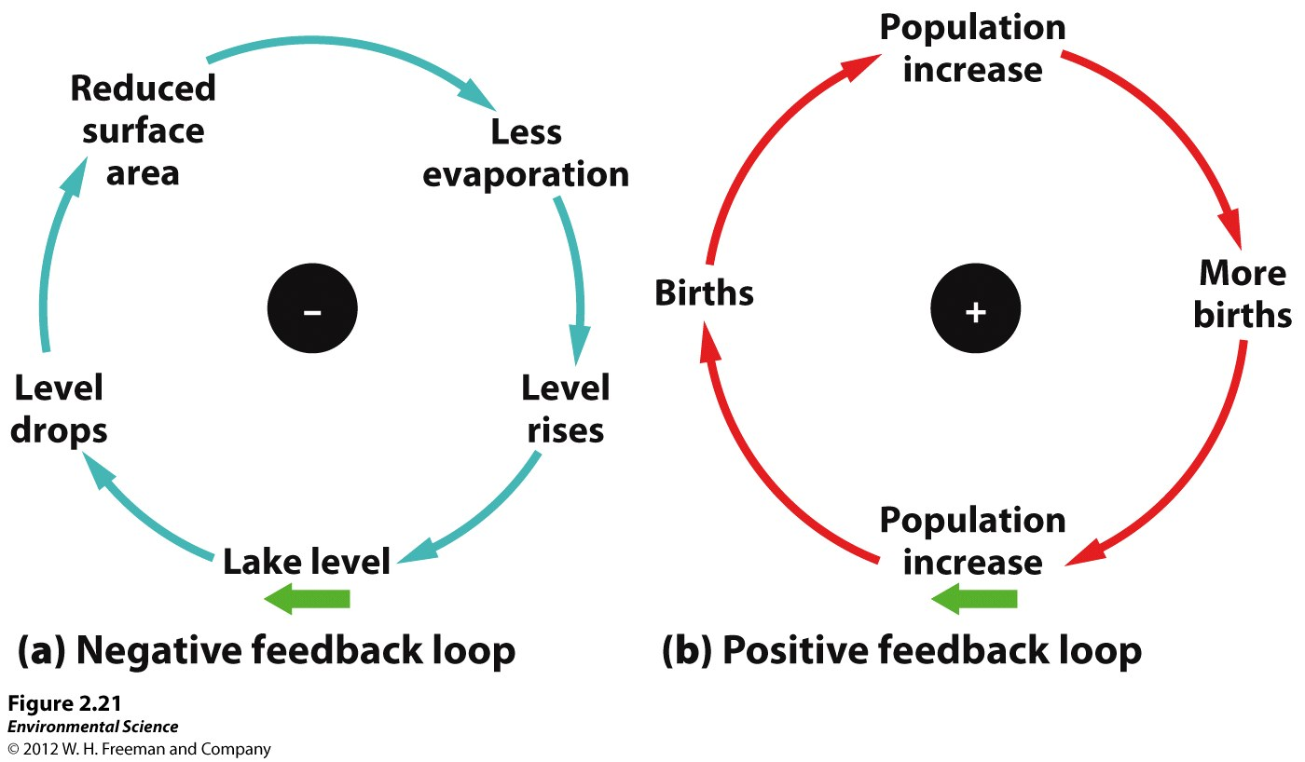

Slide 16
Conversions?
Metric conversions with area, length, mass, temperature, power, energy and volume
Grams to pounds
Acres to hectares
Feet to meters
Kilometers to miles
Fahrenheit to Celsius to Kelvin

Slide 17
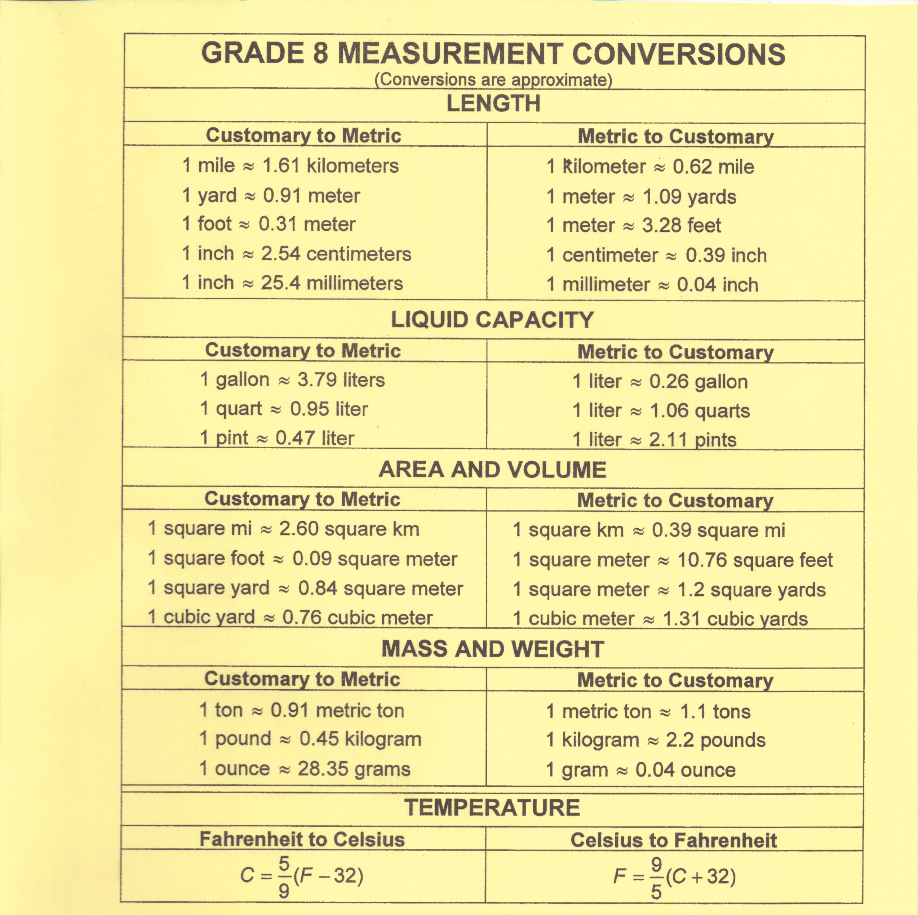

Slide 18
Metric system (SI)
No fractions!
No Naked Numbers!
KHDUDCM
King Henry Died unfortunately Drinking Chocolate Milk

