Slide 1
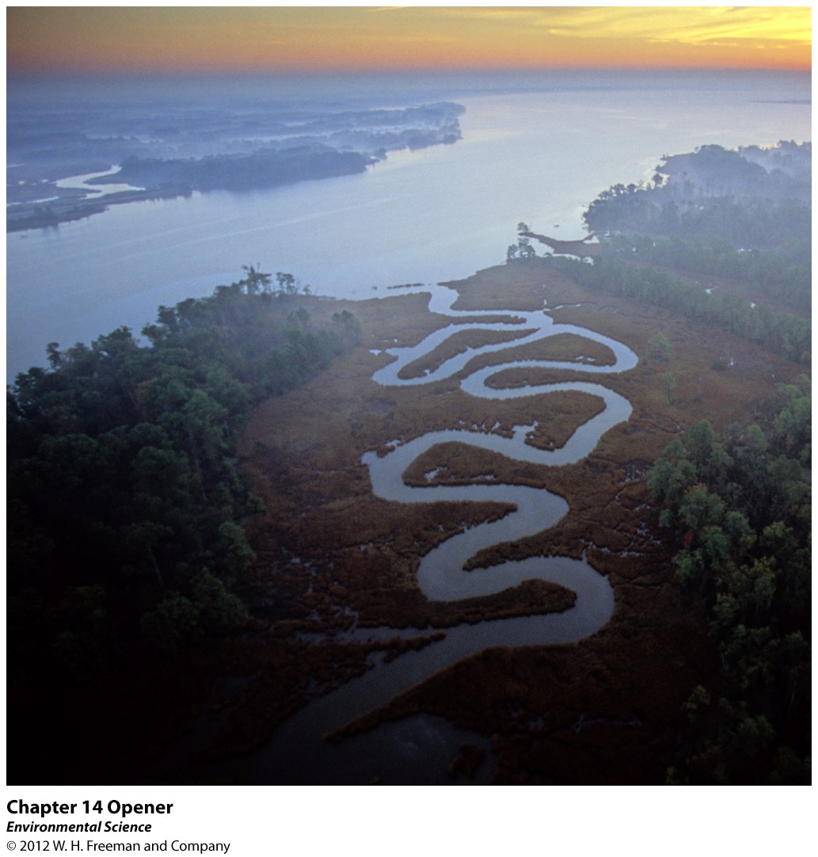
Chapter 14
Water Pollution

Slide 2
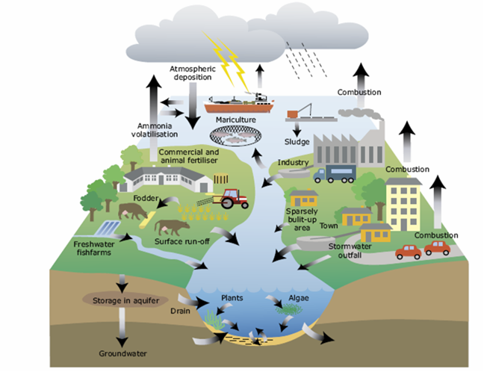
Water Pollution
What is water pollution?
What causes water pollution?

Slide 3
Water Pollution
Water pollution- the contamination of streams, rivers, lakes, oceans, or groundwater with substances produced through human activities and that negatively affect organisms.
https://www.youtube.com/watch?v=74YQWthFz8g

Slide 4
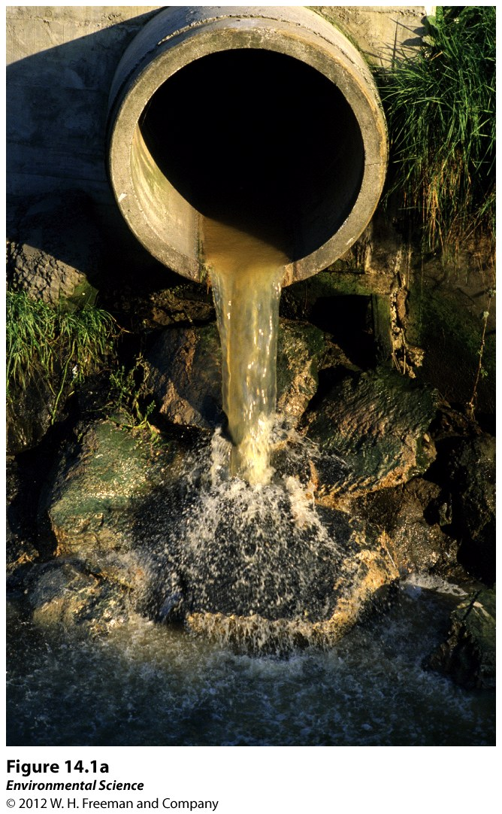
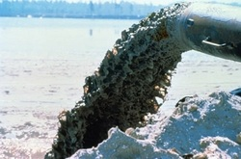
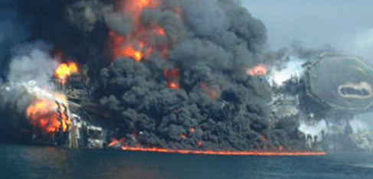
Point sources- distinct locations that pump waste into a waterway.
http://www.gcbl.org/blog/2017/02/landmark-70s-environmental-laws-cleaned-cleveland-cuyahoga-river-and-lake-erie

Slide 5
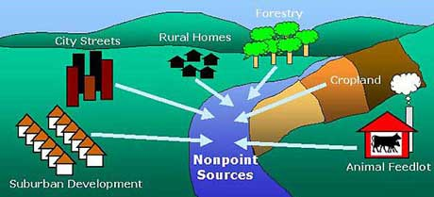
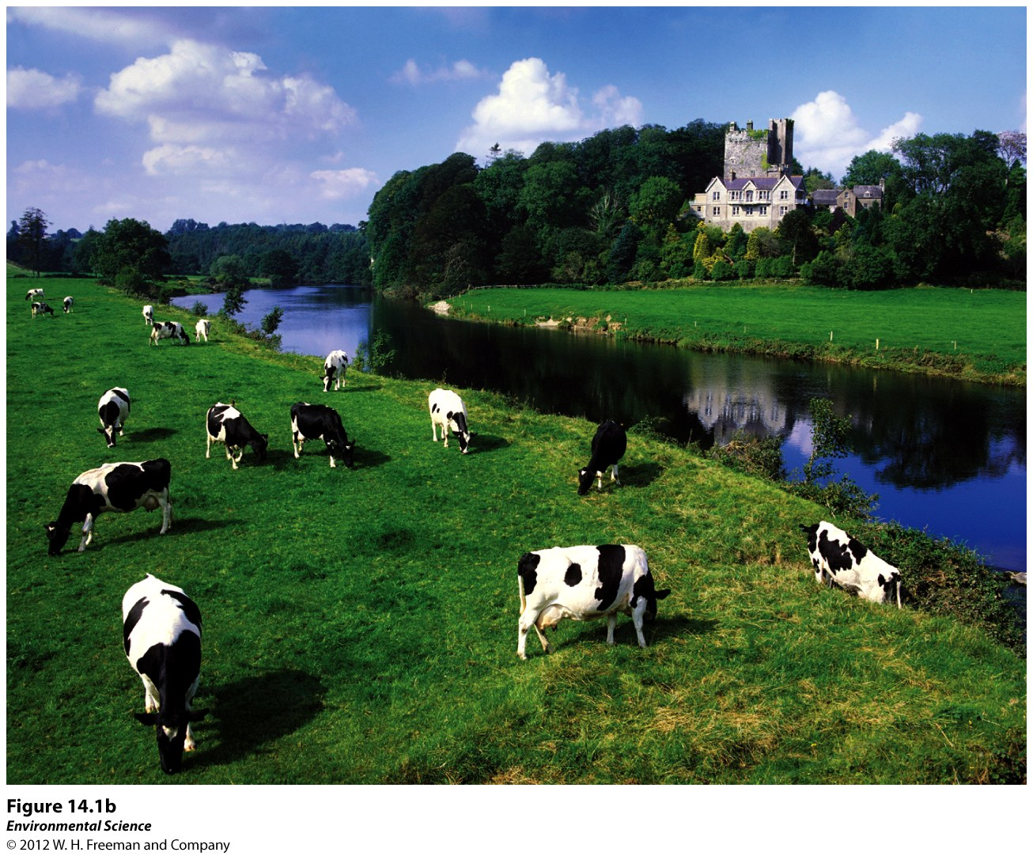
Nonpoint sources- diffuse areas such as an entire farming region that pollutes a waterway.
Difficult to identify and correct

Slide 6
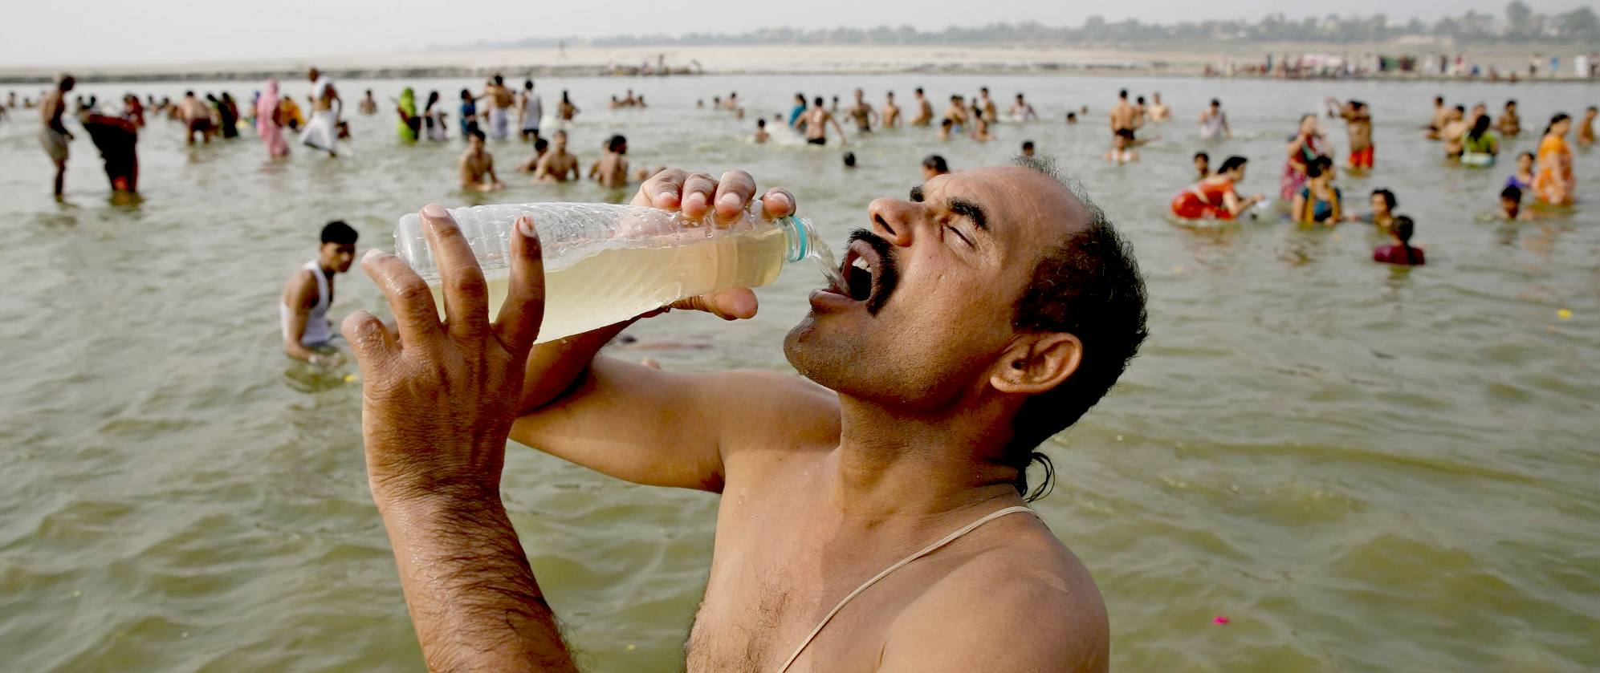
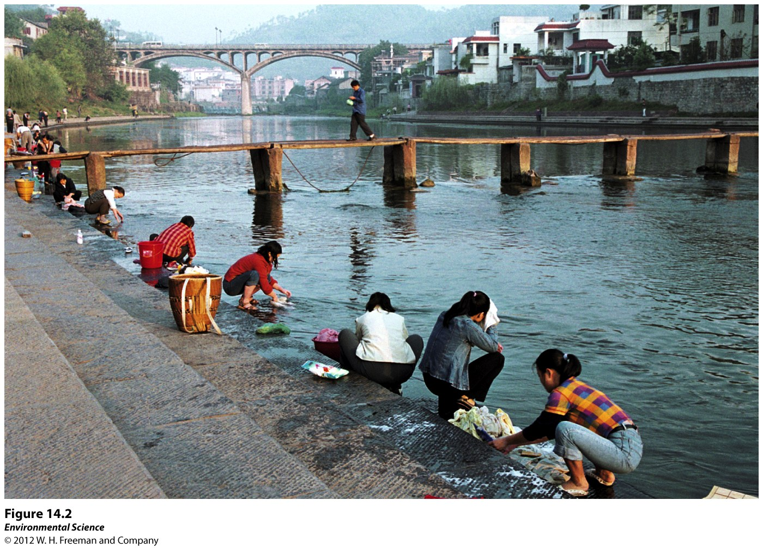
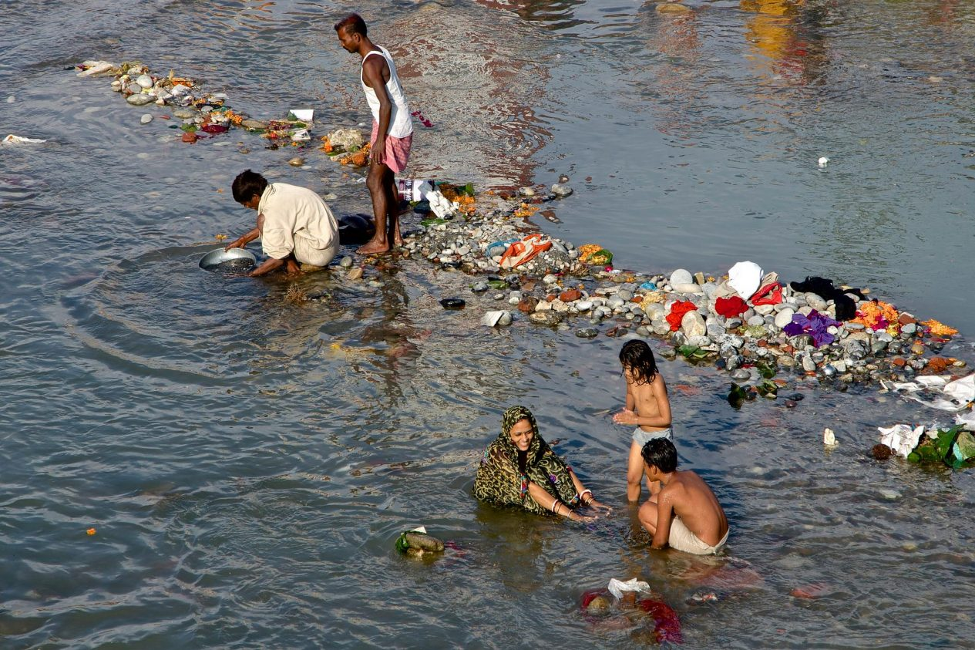
Human Wastewater
Water produced by human activities such as human sewage from toilets and gray water from bathing and washing clothes or dishes.

Slide 7
Three reasons scientists are concerned about human wastewater:
Oxygen-demanding wastes like bacteria that put a large demand for oxygen in the water
Nutrients that are released from wastewater decomposition can make the water more fertile causing eutrophication
Wastewater can carry a wide variety of disease-causing organisms.

Slide 8
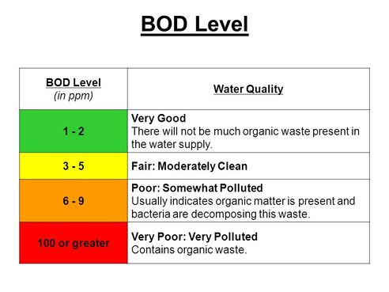
Biochemical Oxygen Demand (BOD)
BOD- the amount of oxygen a quantity of water uses over a period of time at a specific temperature.
Lower BOD values indicate the water is less polluted and higher BOD values indicate it is more polluted by wastewater.

Slide 9
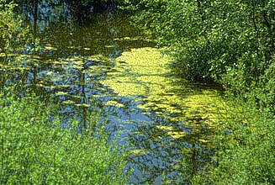
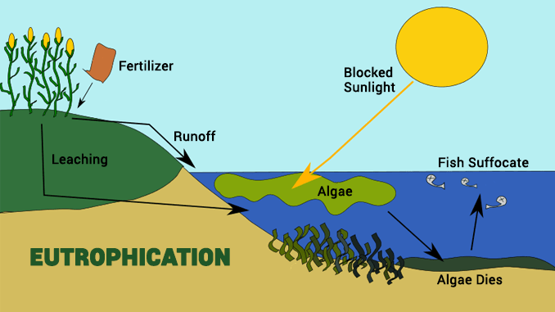
Eutrophication
Eutrophication:
an abundance of fertility to a body of water.
caused by an increase in nutrients, such as fertilizers.
Eutrophication can cause a rapid growth of algae which eventually dies, causing the microbes to increase the BOD.

Slide 10
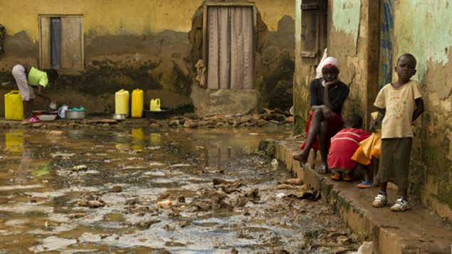
Common Diseases from Human Wastewater
Throughout the world people routinely use the same water source for drinking, bathing and sewage.
Cholera
Typhoid fever
Stomach flu
Diarrhea
Cholera
Hepatitis

Slide 11
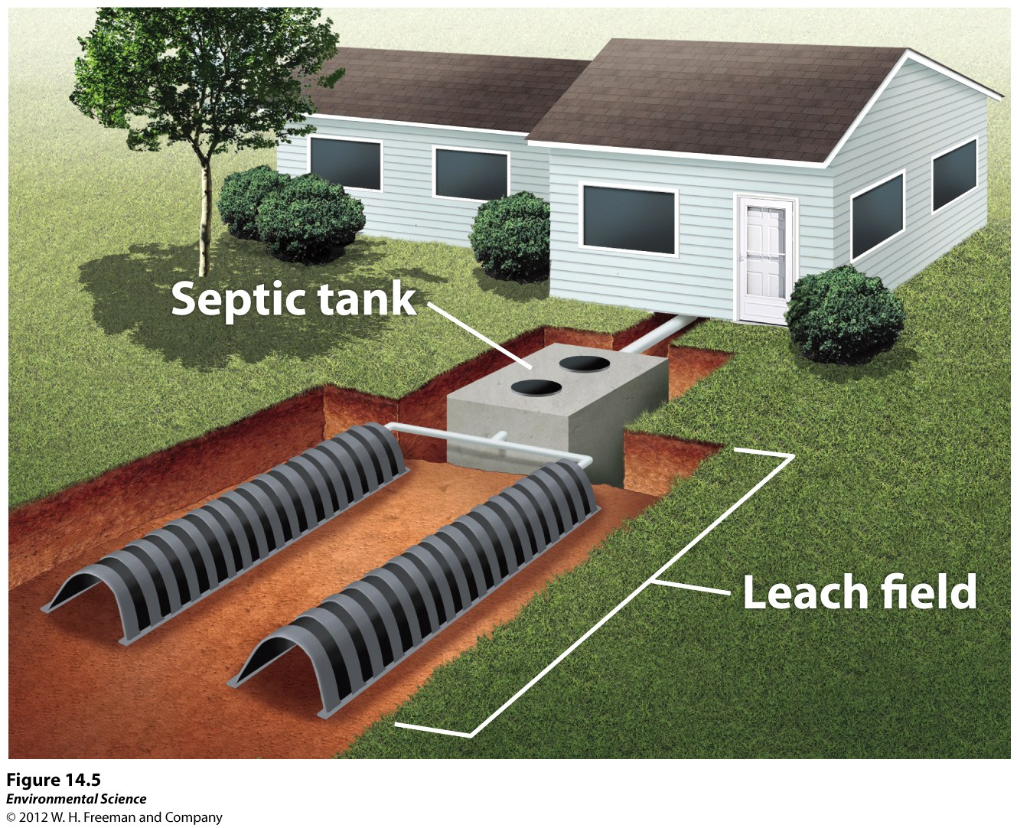
Treatments for Human and Animal Wastewater
Septic systems- a large container that receives wastewater from the house.

Slide 12
Treatments for Human and Animal Wastewater
Sewage Treatment Plants- centralized plants in areas with large populations that receive wastewater via a network of underground pipes.

Slide 13
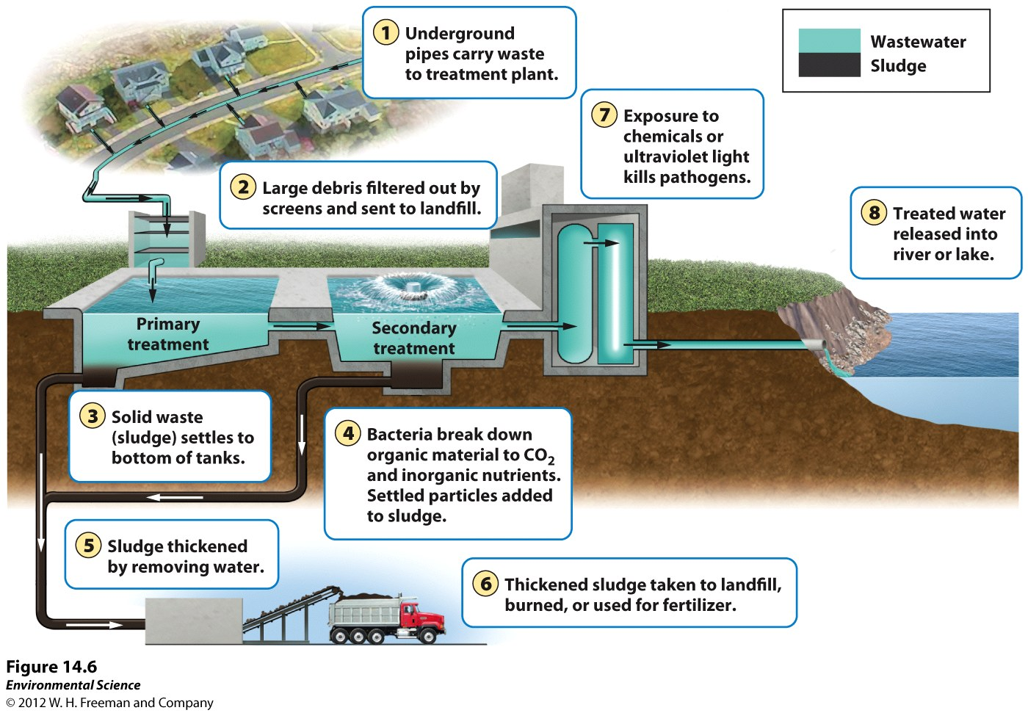

Slide 14
Treatment facilities
Primary treatment - solid waste material to settle out and reduce BOD
Screens
Grit chambers
Up to 20-30% BOD and 60% SS

Slide 15
Treatment facilities
Secondary treatment – breakdown organic matter
Microbes consume the organic matter as food, converting it to carbon dioxide, water, and energy.
85% BOD and all SS

Slide 16
Tertiary treatment
Tertiary treatment - sophisticated technology to further remove contaminants or specific pollutants.
99 percent of all impurities from sewage, but it is a very expensive process.
Boise – UV Treatment
Affects microorganisms ability to reproduce

Slide 17
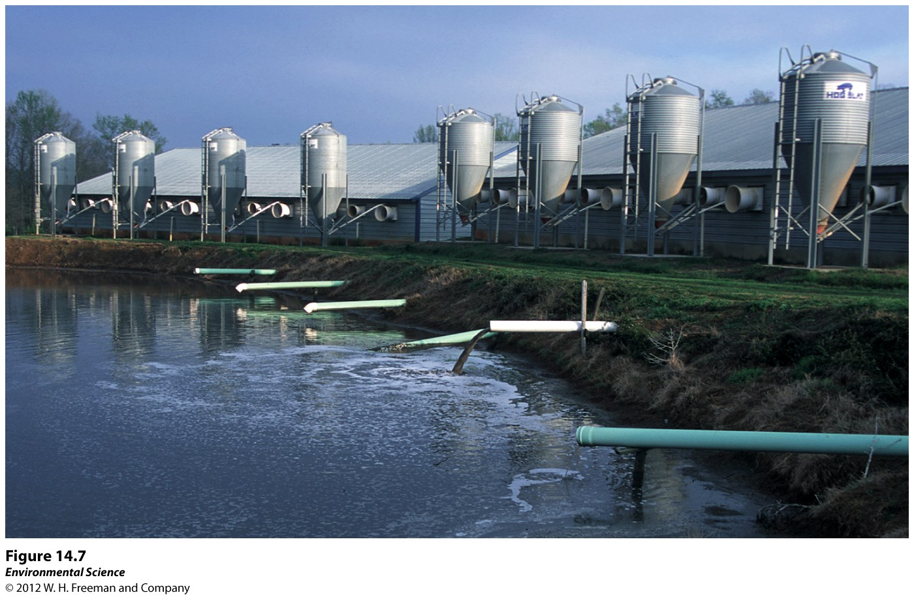
Treatments for Human and Animal Wastewater
Manure lagoons- large, human-made ponds line with rubber to prevent the manure from leaking into the groundwater. After the manure is broken down by bacteria, it is spread onto fields as fertilizers.

Slide 18
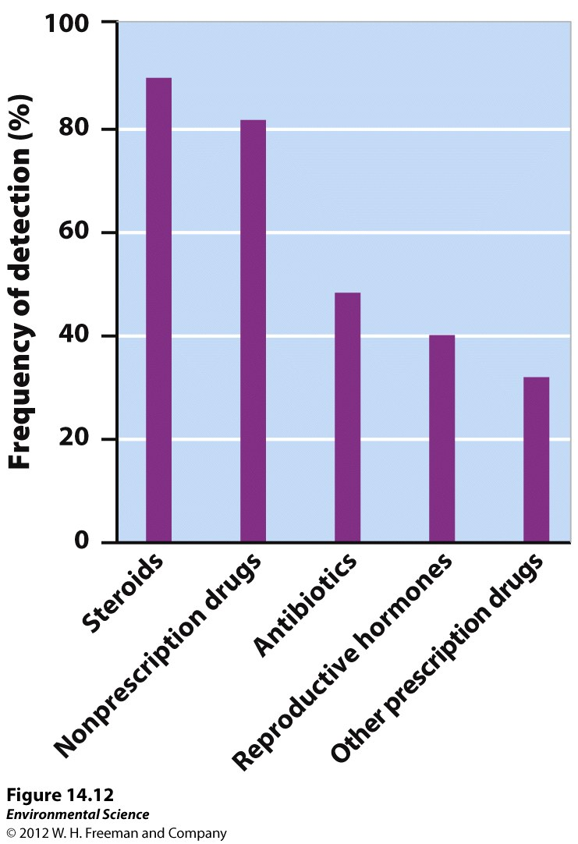
Heavy Metals and Other Substances that can threaten human Health and the Environment
Lead
Arsenic
Mercury
Acids
Synthetic compounds (pesticides, pharmaceuticals, and hormones)

Slide 19
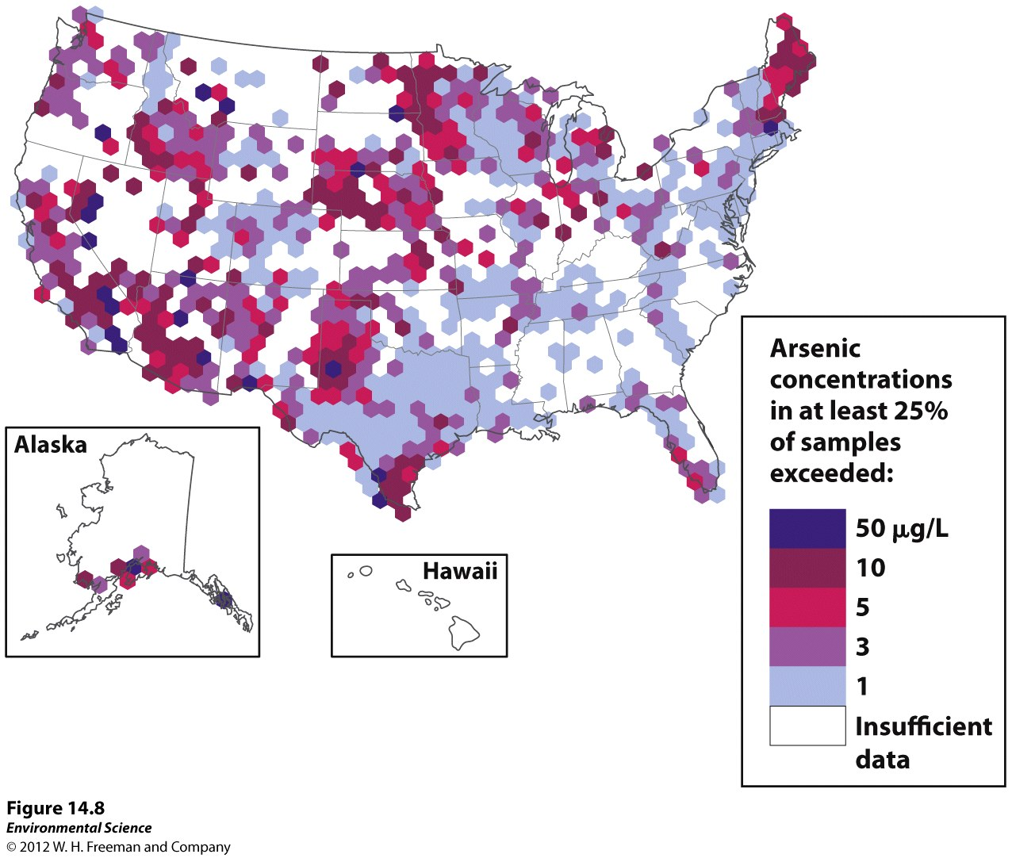

Slide 20
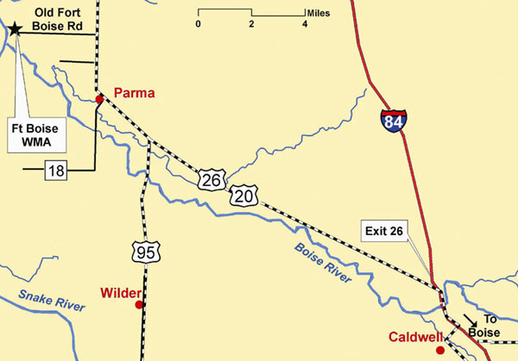
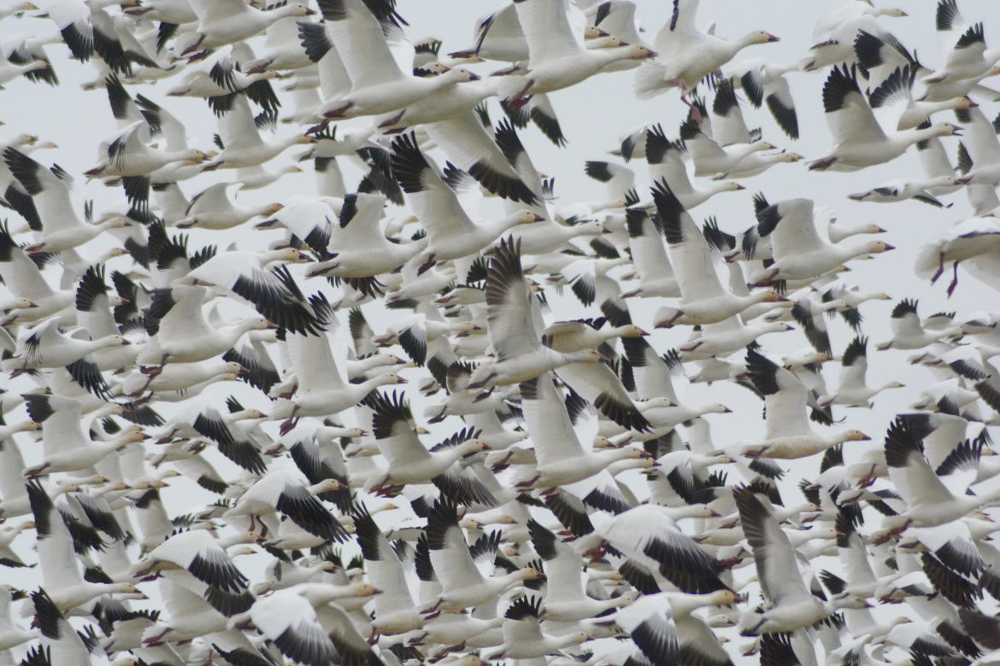
Fort Boise wilderness area

Slide 22
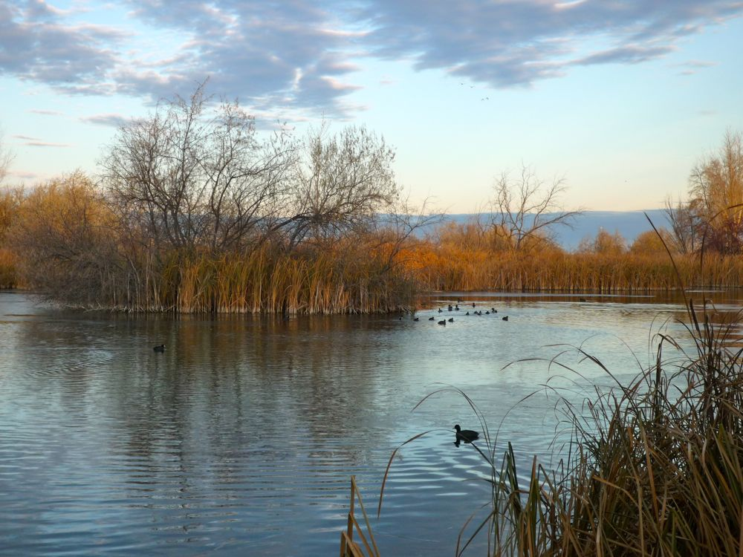
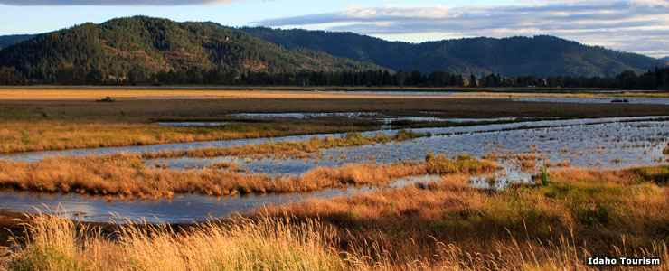
Wetlands
Where water and land meet and mingle
Sponges
reducing flooding and flood damage
Reduce pollution

Slide 23
Wetlands as an filtration process
filters for water coming off the land
reducing sediment and chemicals in run off before it gets into open water.
water flow slows so suspended sediment drops out and settles to the wetland floor
Nutrients from manure, sewage systems, and other sources are absorbed for leaf and stem growth of plants. Others are trapped in the soil and used by microorganisms there. (Environmental Protection Agency b, 2001)

Slide 24
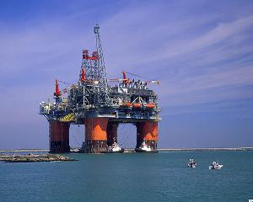
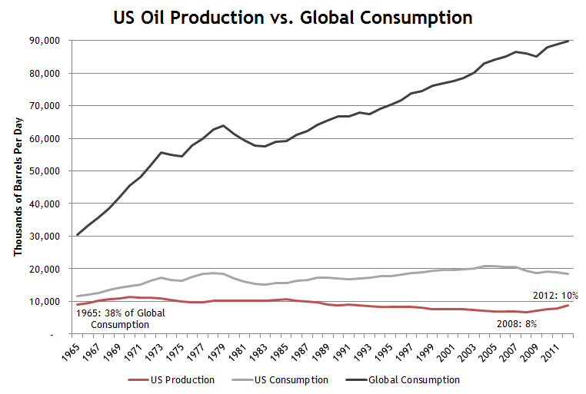

Slide 25
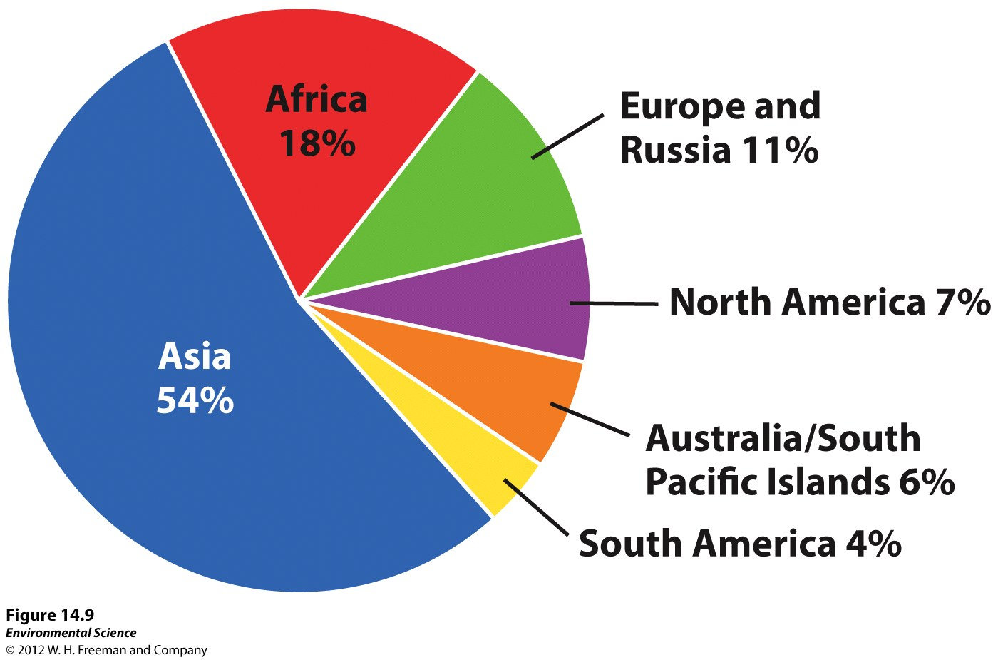

Slide 27
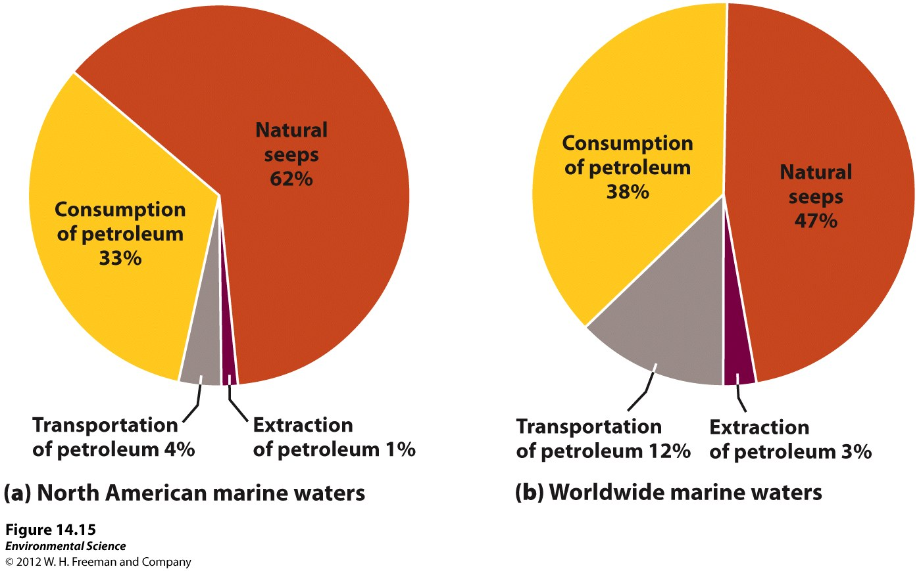
Oil Pollution

Slide 28
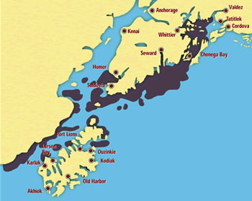
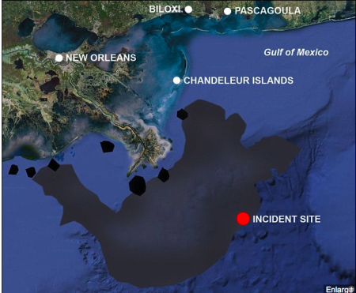
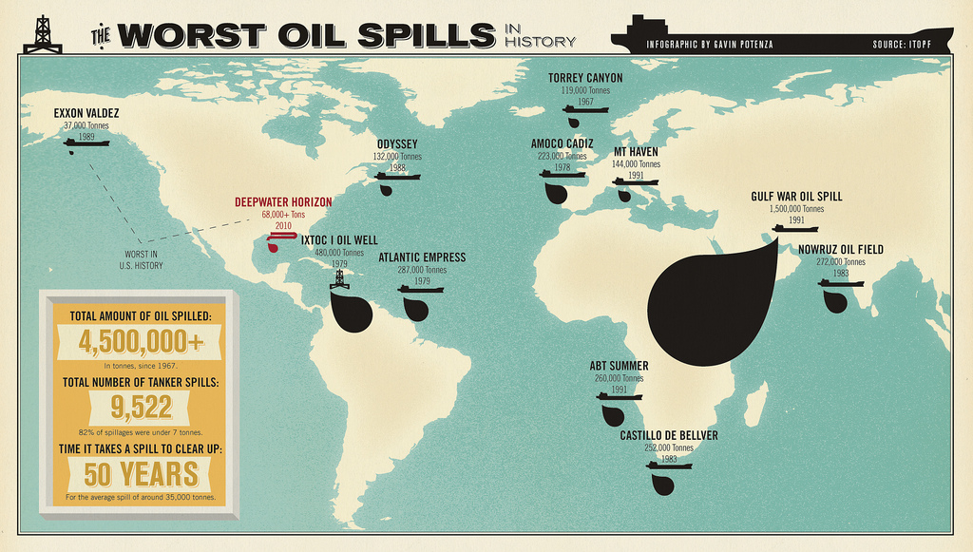
Disaster occurred

Slide 30
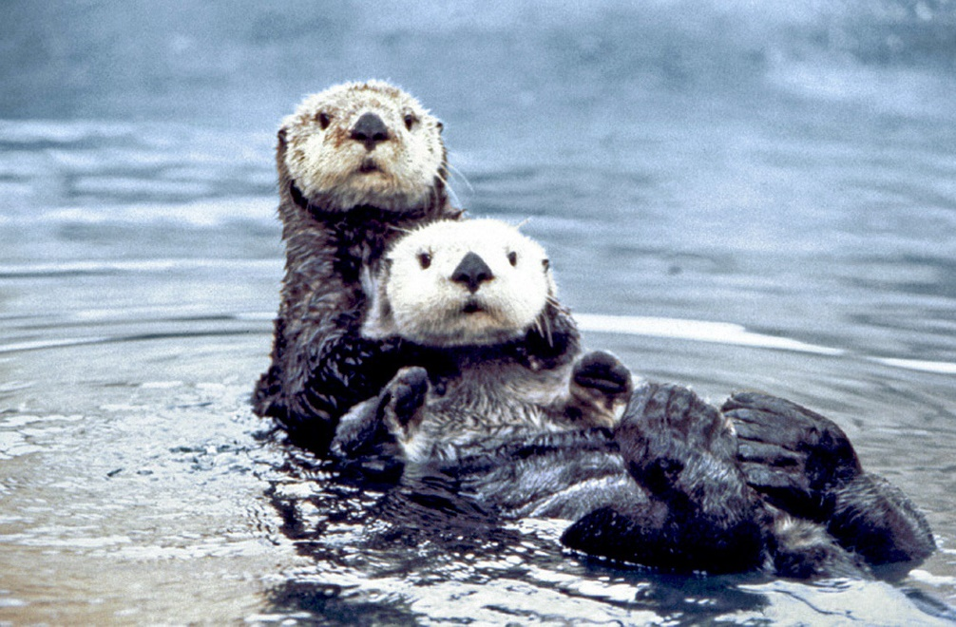
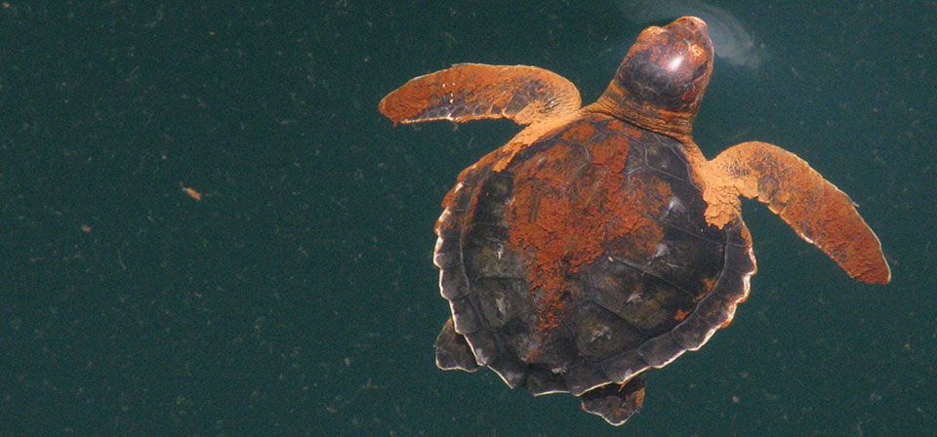

Slide 31
Ways to Remediate Oil Pollution
Containment using booms to keep the floating oil from spreading.
Chemicals that help break up the oil, making it disperse before it hits the shoreline.
Bacteria that are genetically engineered to consume oil

Slide 32
Other Water Pollutants
Solid waste pollution (garbage)
Sediment pollution (sand, silt and clay)
Thermal pollution
Noise pollution

Slide 33
Water Laws
Clean Water Act- (1972) supports the “protection and propagation of fish, shellfish, and wildlife and recreation in and on the water”.
Issued water quality standards that defined acceptable limits of various pollutants in U.S. waterways.

Slide 34
Water Laws
Safe Drinking Water Act- (1974, 1986, 1996) sets the national standards for safe drinking water.
It is responsible for establishing maximum contaminant levels (MCL) for 77 different elements or substances in both surface water and groundwater.

Slide 36
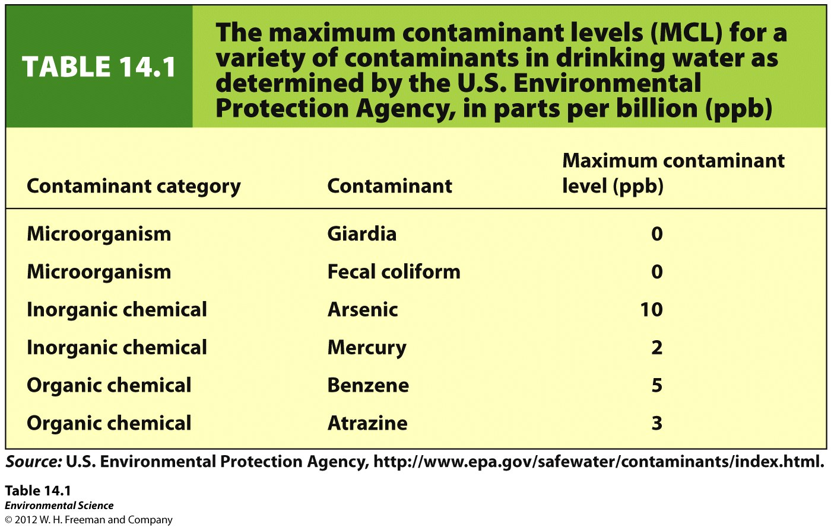

Slide 37
