Slide 2
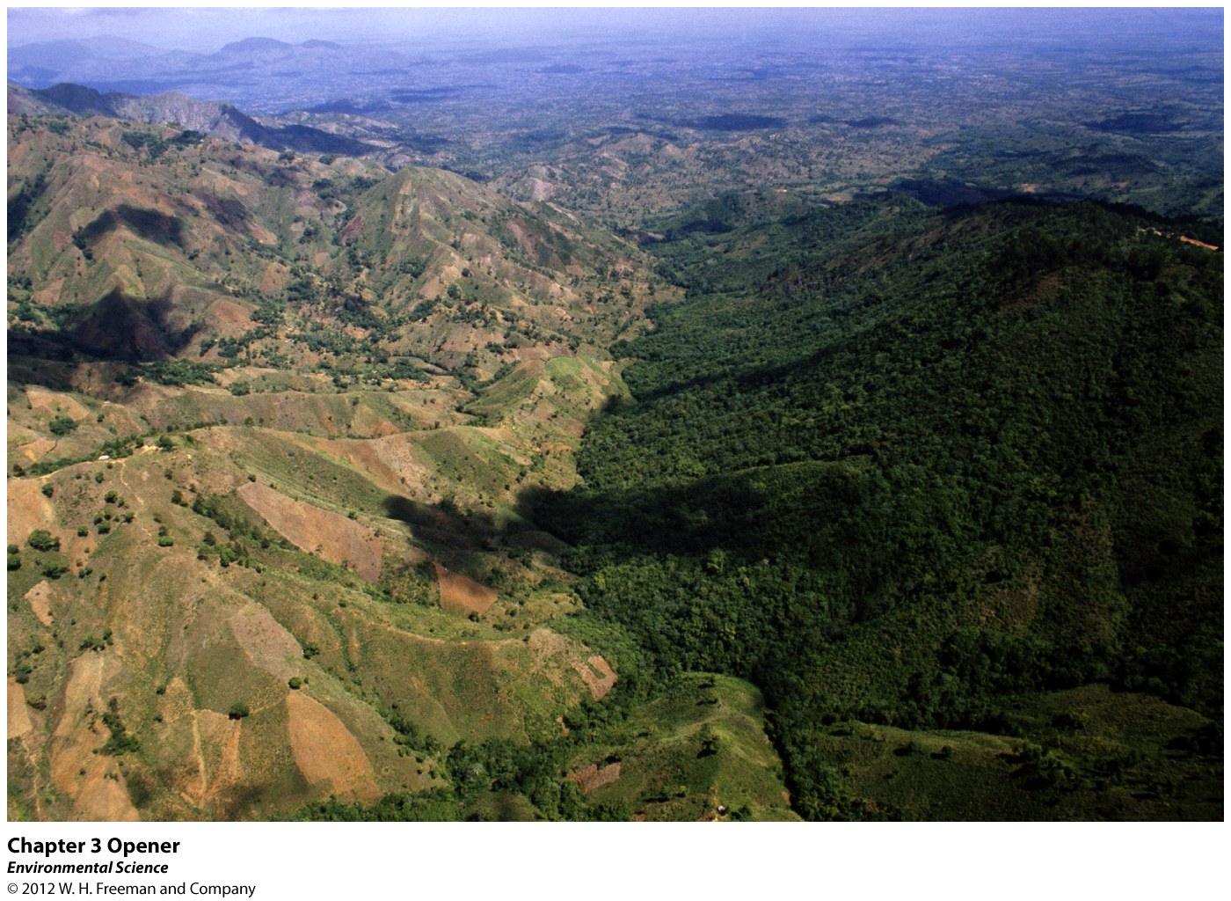
Chapter 3
Ecosystem Ecology

Slide 3
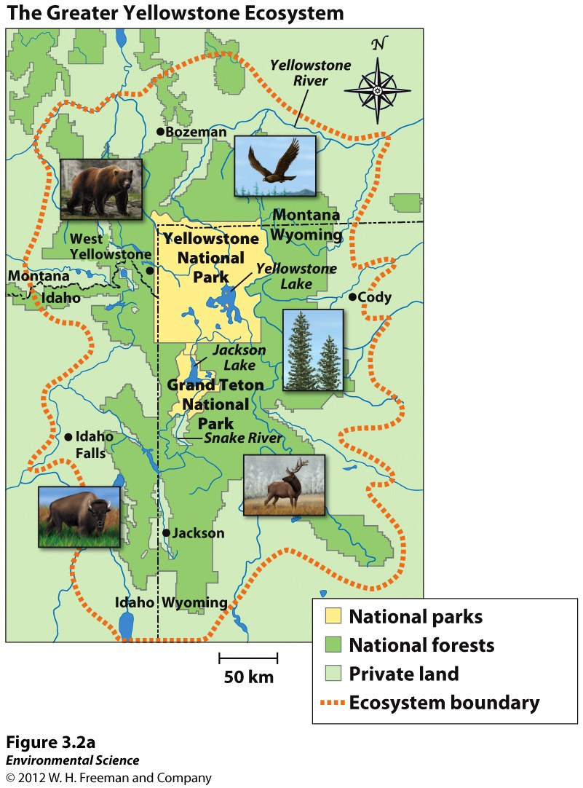
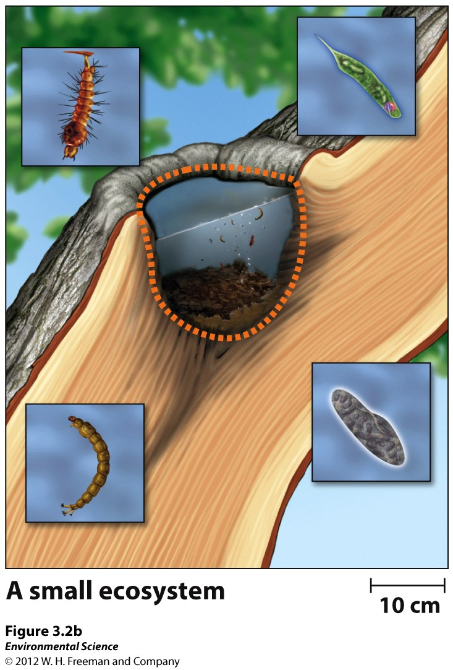

Slide 4
Ecosystem Boundaries
Biotic and abiotic components
Terrestrial ecosystem
Range of a particular species of interest
Topographic features
Administrative
Physical and chemical components

Slide 5
Energy conversions underlie all ecological processes
Life requires order.
If organisms were not made up of molecules organized into structures such as proteins and cells, they could not grow—in fact, they could never develop in the first place. All living things work against entropy by using energy to maintain order.
The form and amount of energy available in an environment determines what kinds of organisms can live there.

Slide 6
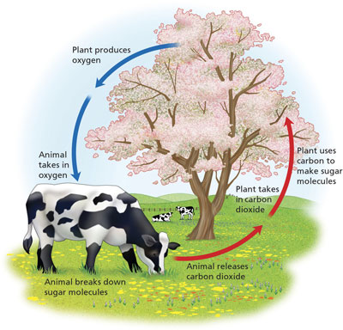
Photosynthesis & Cellular Respiration How Energy Flows through an Ecosystem

Slide 7
What do you remember about Photosynthesis and Cellular Respiration?
What performs each process?
Purpose of each process?
What are the reactants & products?

Slide 8
Photosynthesis and Respiration
Producers (autotrophs) are able to use the suns energy to produce usable energy through the process called photosynthesis.

Slide 9
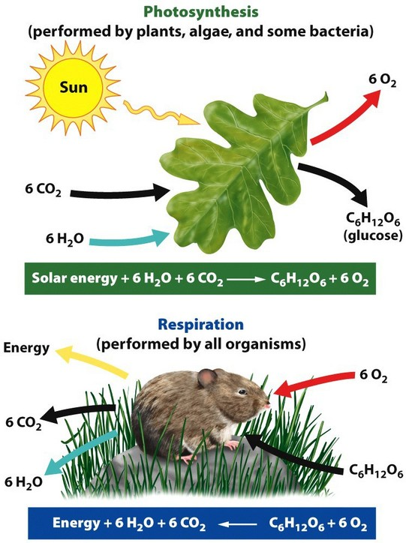

Slide 10
Photosynthesis and Respiration
Cellular respiration is the process by which other organisms gain energy from eating the tissues of producers.

Slide 12
Trophic Levels, Food Chains, and Food Webs
Consumers (heterotrophs)- obtain energy by consuming other organisms.
Primary Consumers (herbivores)- consume producers.
Secondary Consumers (carnivores)- obtain their energy by eating primary consumers.
Tertiary Consumers (carnivores)- eat secondary consumers.

Slide 13
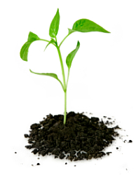
Photosynthesis & Cellular Respiration
All organisms—including producers—carry out respiration to fuel their own metabolism and growth.
Producers generate more O2 via photosynthesis than they consume via respiration (net production of O2)
Producers only respire, consuming O2 without generating it, yet producers photosynthesize more than they respire.
Net effect is an excess of oxygen that is released into the air and an excess of carbon that is stored in the tissues of producers.

Slide 14
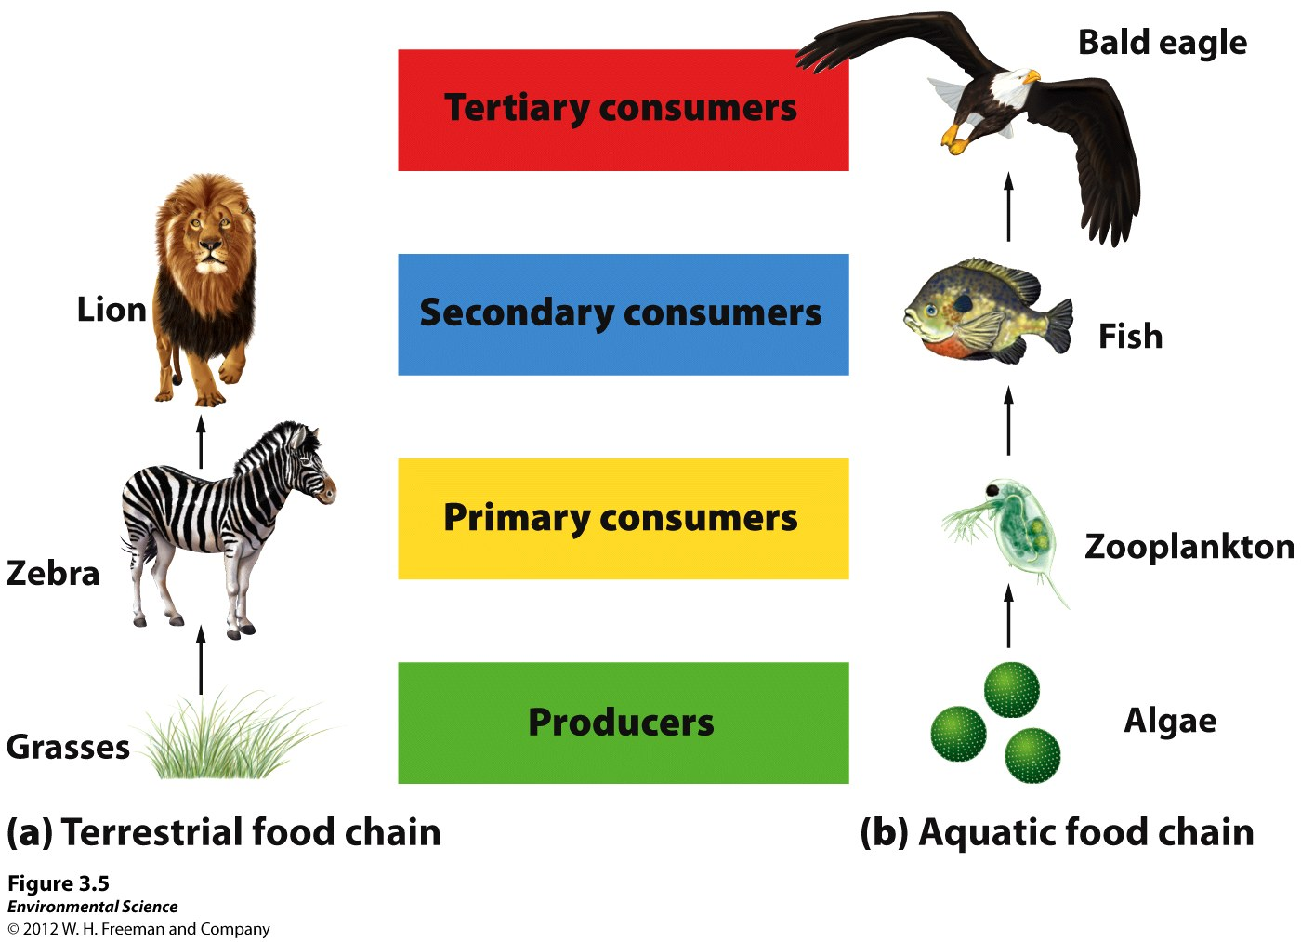
FOOD CHAIN

Slide 15
Food Chain- The sequence of consumption from producers through tertiary consumers.
Food Web- A more realistic type of food chain that takes into account the complexity of nature.

Slide 16
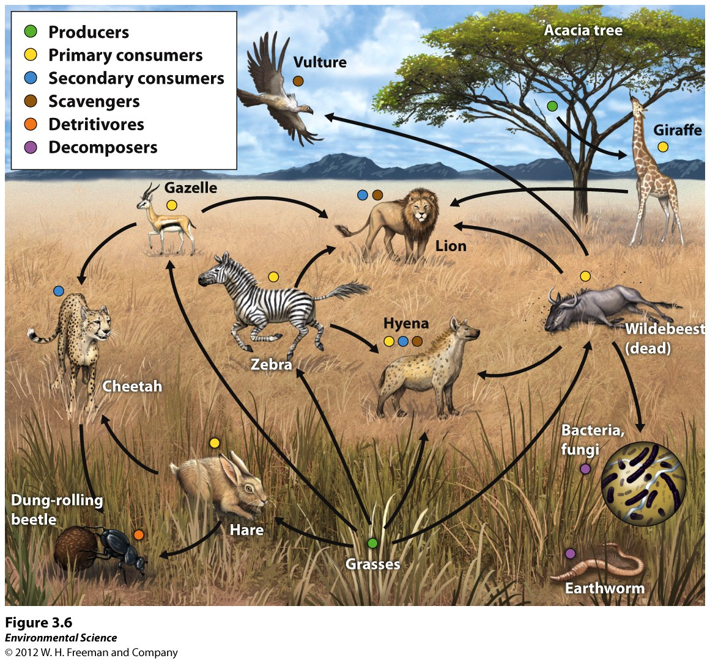
FOOD WEB

Slide 17
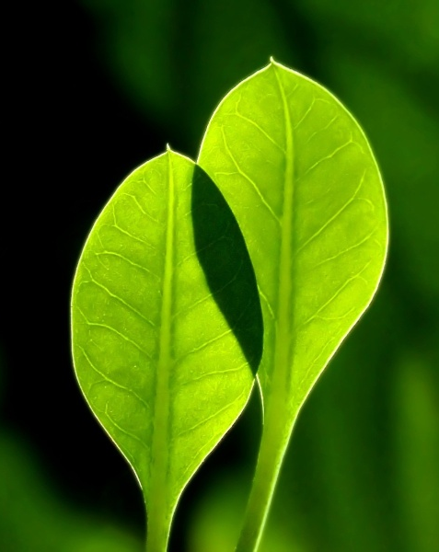
Ecosystem Productivity
Environmental scientists look at the total amount of solar energy that the producers in an ecosystem capture via photosynthesis over a given amount of time = gross primary productivity (GPP) of the ecosystem.
Note that the term gross, as used here, indicates the total amount of energy captured by producers.
Energy captured - the energy respired by producers =
ecosystem’s net primary productivity (NPP):
NPP = GPP − respiration by producers
Ex. Think paycheck.
Notes:
GPP = what employer pays you; NPP = what you take home.

Slide 18
Ecosystem Productivity
GPP is essentially a measure of how much photosynthesis is occurring over some amount of time.
Unfortunately converting sunlight into chemical energy is not an efficient process.

Slide 19
Ecosystem Productivity
Gross primary productivity (GPP)- The total amount of solar energy that the producers in an ecosystem capture via photosynthesis over a given amount of time.
Net primary productivity (NPP)- The energy captured (GPP) minus the energy respired by producers.
NPP= GPP- respiration

Slide 20
What determines the productivity of an ecosystem?
The amount of energy available
Measuring? Look at the rate at which the CO₂ is taken up during photosynthesis and the rate it is produced in cellular respiration.
Units are kg C/m₂/day

Slide 21
The net primary productivity of an ecosystem is 1 kg C/m₂/year, and the energy needed by the producers for their own respiration is 1.5 kg C/m₂/year. The gross primary productivity of such an ecosystem would be?
NPP= GPP- respiration

Slide 22
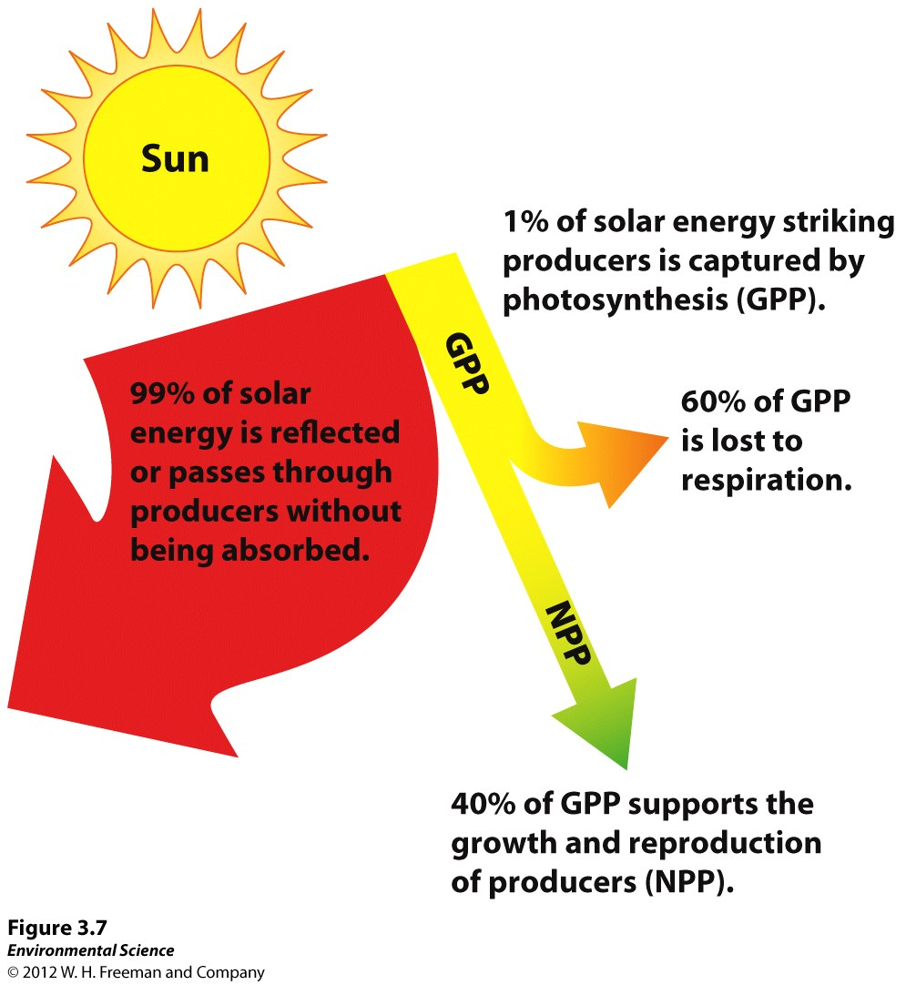
Convert sunlight not efficient
1% captured
Of that energy- 60% lost to respiration and 40% supports growth and reproduction
Measuring NPP measures change in an ecosystem.

Slide 24
Energy Transfer Efficiency and Trophic Pyramids
Biomass- The energy in an ecosystem is measured in terms of biomass.
Standing crop- The amount of biomass present in an ecosystem at a particular time.
Ecological efficiency- The proportion of consumed energy that can be passed from one trophic level to another.
Trophic pyramid- The representation of the distribution of biomass among trophic levels.

Slide 25
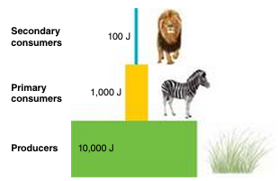
Energy Transfer Efficiency and Trophic Pyramids

Slide 26
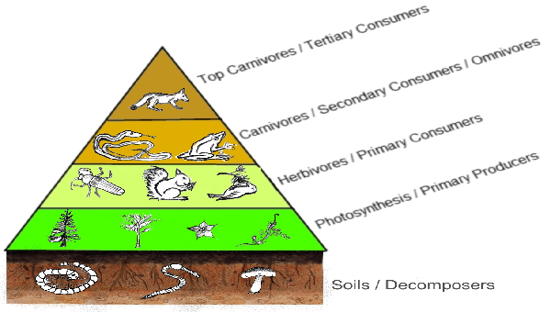
An ecosystem has an ecological efficiency of 10% . If the producer level contains 10,000 kcal of energy, how much energy does the tertiary consumer level contain?

Slide 27
Chapter 3
Ecosystem Ecology

Slide 29
Ecosystem Boundaries
Biotic and abiotic components
Terrestrial ecosystem
Range of a particular species of interest
Topographic features
Administrative
Physical and chemical components

Slide 30
Energy conversions underlie all ecological processes
Life requires order.
If organisms were not made up of molecules organized into structures such as proteins and cells, they could not grow—in fact, they could never develop in the first place. All living things work against entropy by using energy to maintain order.
The form and amount of energy available in an environment determines what kinds of organisms can live there.

Slide 31
Photosynthesis & Cellular Respiration How Energy Flows through an Ecosystem

Slide 32
What do you remember about Photosynthesis and Cellular Respiration?
What performs each process?
Purpose of each process?
What are the reactants & products?

Slide 33
Photosynthesis and Respiration
Producers (autotrophs) are able to use the suns energy to produce usable energy through the process called photosynthesis.

Slide 35
Photosynthesis and Respiration
Cellular respiration is the process by which other organisms gain energy from eating the tissues of producers.

Slide 37
Trophic Levels, Food Chains, and Food Webs
Consumers (heterotrophs)- obtain energy by consuming other organisms.
Primary Consumers (herbivores)- consume producers.
Secondary Consumers (carnivores)- obtain their energy by eating primary consumers.
Tertiary Consumers (carnivores)- eat secondary consumers.

Slide 38
Photosynthesis & Cellular Respiration
All organisms—including producers—carry out respiration to fuel their own metabolism and growth.
Producers generate more O2 via photosynthesis than they consume via respiration (net production of O2)
Producers only respire, consuming O2 without generating it, yet producers photosynthesize more than they respire.
Net effect is an excess of oxygen that is released into the air and an excess of carbon that is stored in the tissues of producers.

Slide 39
FOOD CHAIN

Slide 40
Food Chain- The sequence of consumption from producers through tertiary consumers.
Food Web- A more realistic type of food chain that takes into account the complexity of nature.

Slide 41
FOOD WEB

Slide 42
Ecosystem Productivity
Environmental scientists look at the total amount of solar energy that the producers in an ecosystem capture via photosynthesis over a given amount of time = gross primary productivity (GPP) of the ecosystem.
Note that the term gross, as used here, indicates the total amount of energy captured by producers.
Energy captured - the energy respired by producers =
ecosystem’s net primary productivity (NPP):
NPP = GPP − respiration by producers
Ex. Think paycheck.
Notes:
GPP = what employer pays you; NPP = what you take home.

Slide 43
Ecosystem Productivity
GPP is essentially a measure of how much photosynthesis is occurring over some amount of time.
Unfortunately converting sunlight into chemical energy is not an efficient process.

Slide 44
Ecosystem Productivity
Gross primary productivity (GPP)- The total amount of solar energy that the producers in an ecosystem capture via photosynthesis over a given amount of time.
Net primary productivity (NPP)- The energy captured (GPP) minus the energy respired by producers.
NPP= GPP- respiration

Slide 45
What determines the productivity of an ecosystem?
The amount of energy available
Measuring? Look at the rate at which the CO₂ is taken up during photosynthesis and the rate it is produced in cellular respiration.
Units are kg C/m₂/day

Slide 46
The net primary productivity of an ecosystem is 1 kg C/m₂/year, and the energy needed by the producers for their own respiration is 1.5 kg C/m₂/year. The gross primary productivity of such an ecosystem would be?
NPP= GPP- respiration

Slide 47
Convert sunlight not efficient
1% captured
Of that energy- 60% lost to respiration and 40% supports growth and reproduction
Measuring NPP measures change in an ecosystem.

Slide 49
Energy Transfer Efficiency and Trophic Pyramids
Biomass- The energy in an ecosystem is measured in terms of biomass.
Standing crop- The amount of biomass present in an ecosystem at a particular time.
Ecological efficiency- The proportion of consumed energy that can be passed from one trophic level to another.
Trophic pyramid- The representation of the distribution of biomass among trophic levels.

Slide 50
Energy Transfer Efficiency and Trophic Pyramids

Slide 51
An ecosystem has an ecological efficiency of 10% . If the producer level contains 10,000 kcal of energy, how much energy does the tertiary consumer level contain?

