Slide 1
Matter cycles through the biosphere
Biosphere- The combination of all ecosystems on Earth.
Biogeochemical cycles- The movement of matter within and between ecosystems involving biological, geologic and chemical processes.

Slide 2
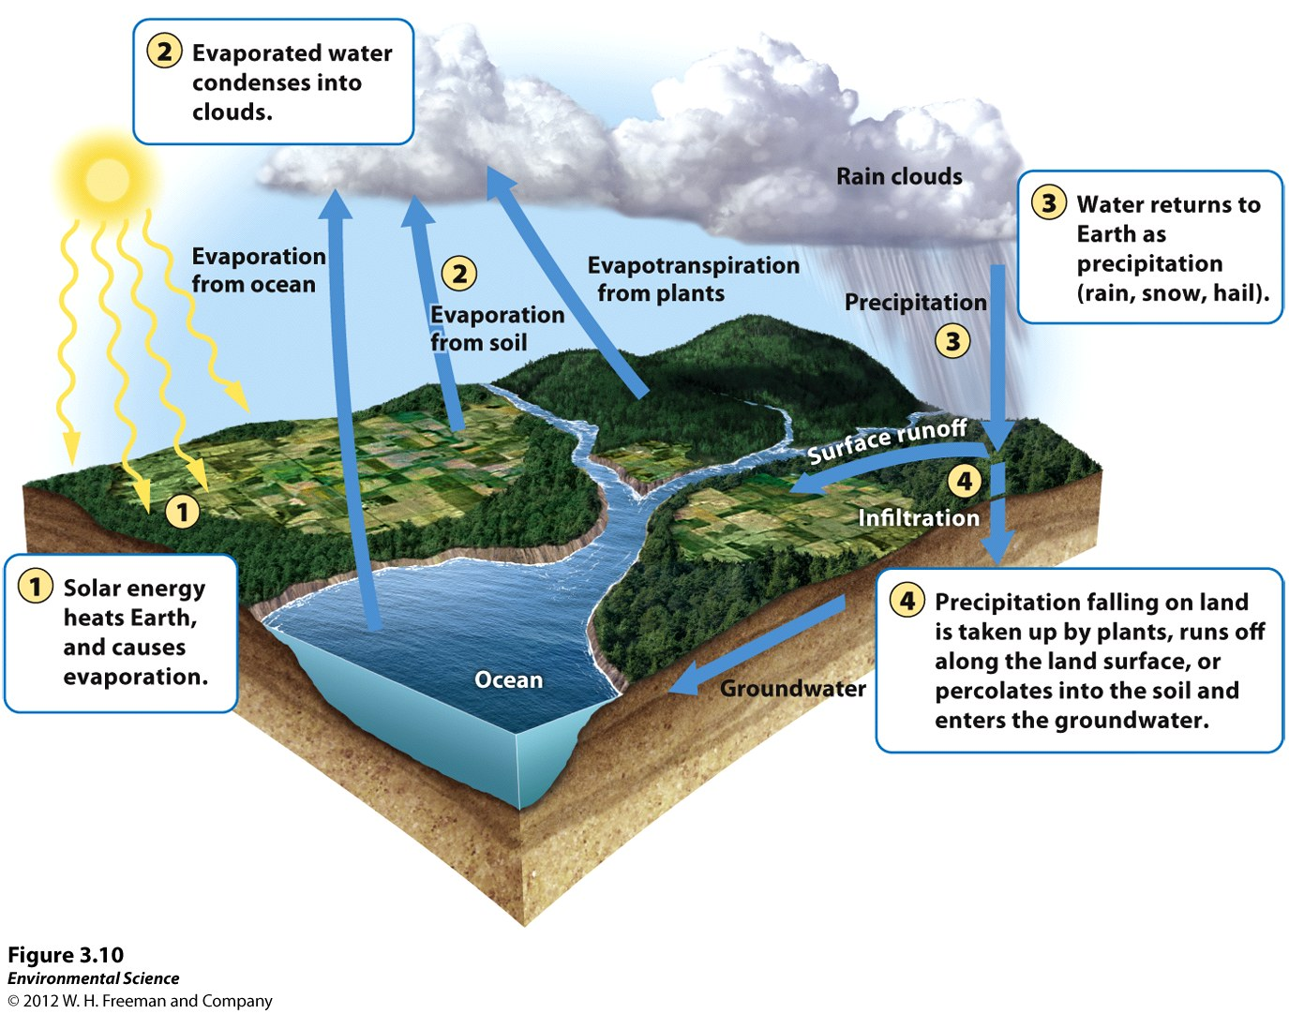
The Hydrologic Cycle
The movement of water through the biosphere.

Slide 3
The Hydrologic Cycle
Transpiration- The process where plants release water from their leaves into the atmosphere.
Evapotranspiration- The combined amount of evaporation and transpiration.
Runoff- When water moves across the land surface into streams and rivers, eventually reaching the ocean.

Slide 4
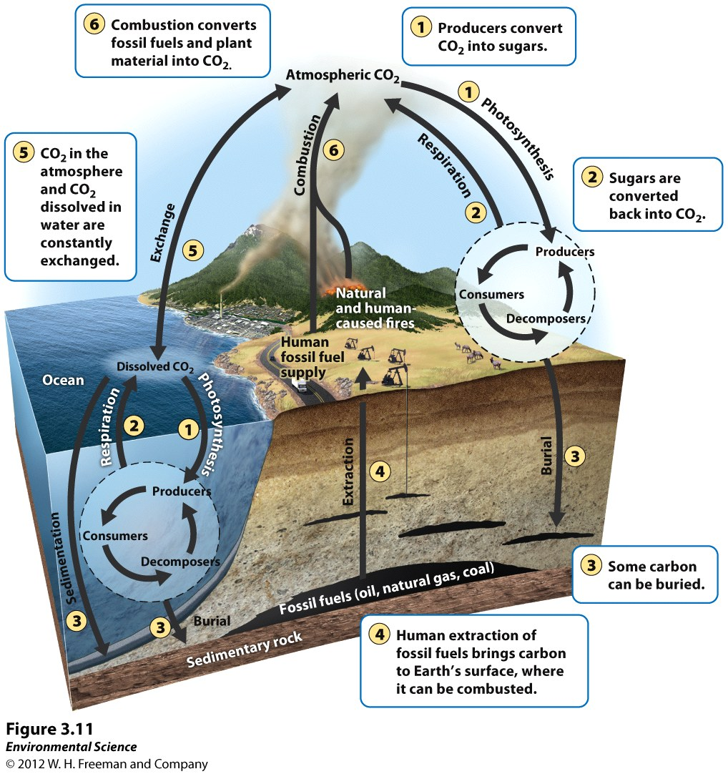
The Carbon Cycle

Slide 5
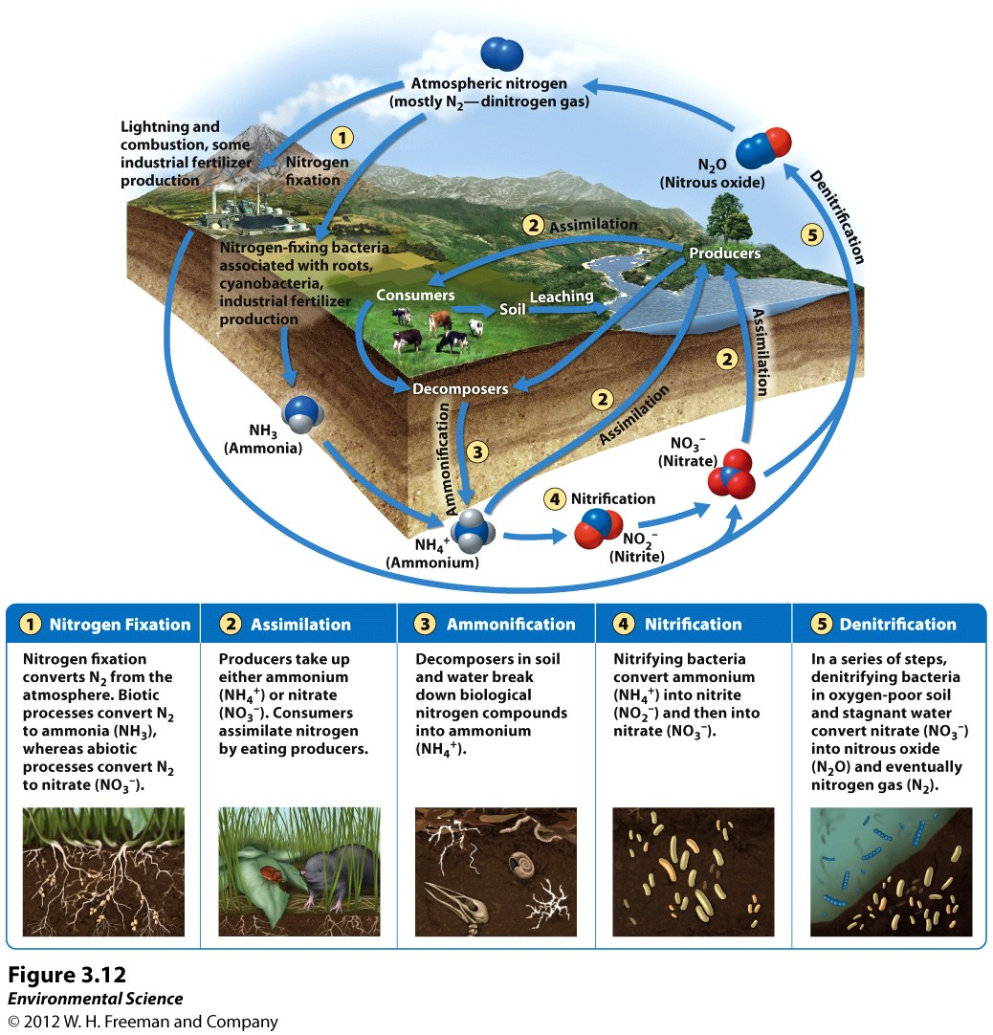
The Nitrogen Cycle

Slide 6
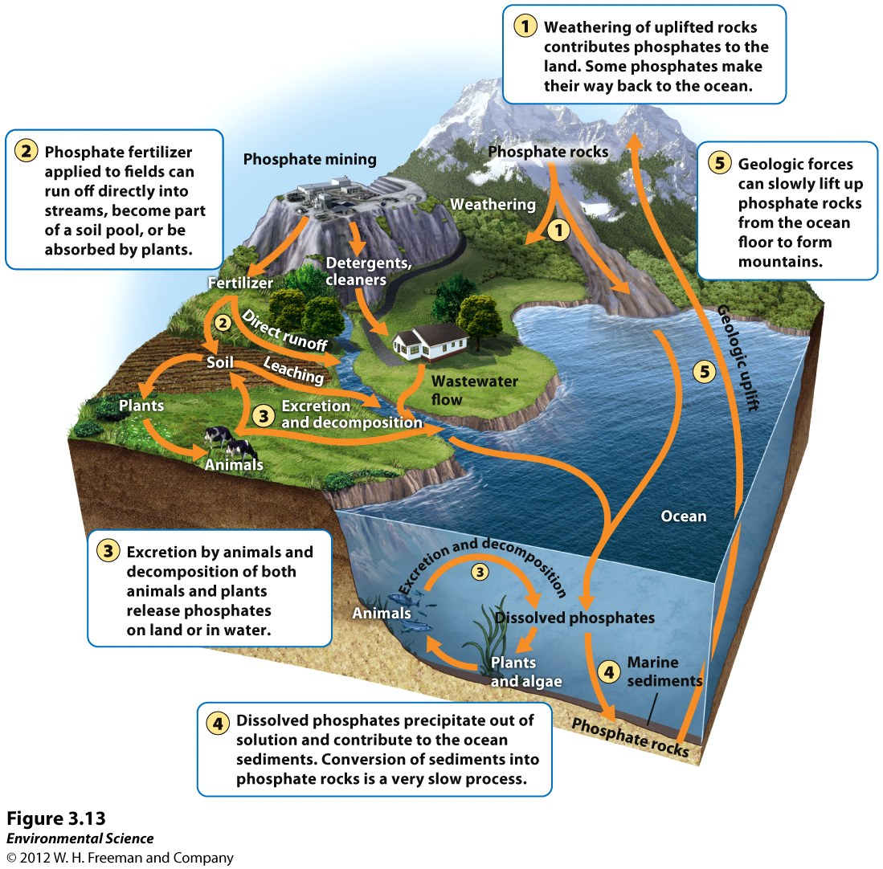
The Phosphorus Cycle

Slide 7
Ecosystems respond to disturbance
Disturbance- An event caused by physical, chemical or biological agents that results in changes in population size or community composition.
Examples- natural and anthropogenic
Ecologists look at how this impacts flow of matter and energy
Resist? Recover?

Slide 8
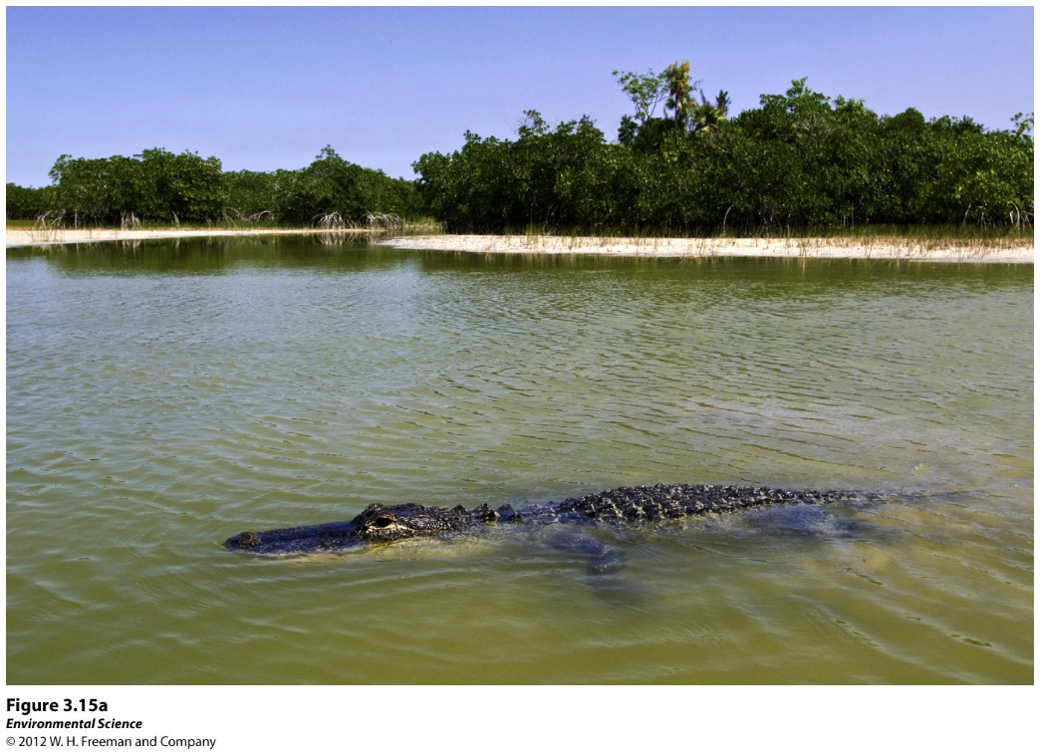
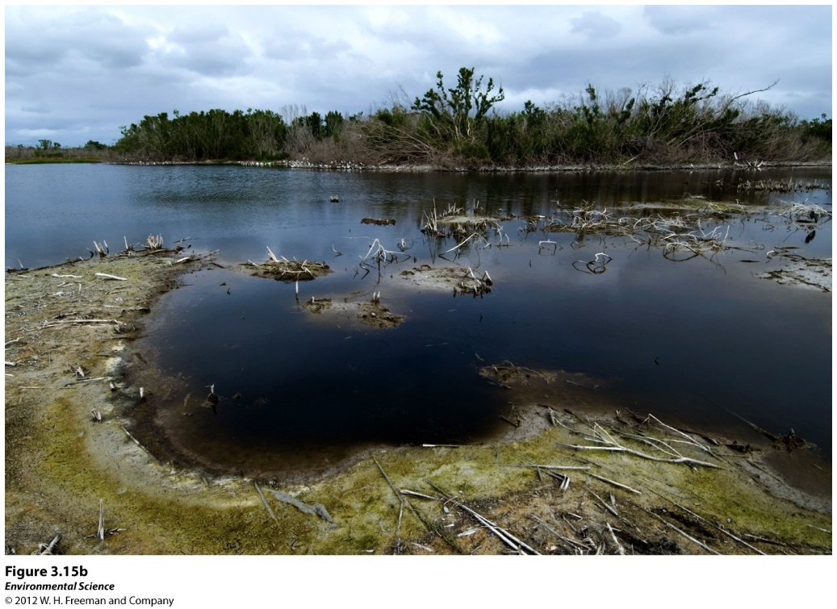

Slide 9
Hubbard Brook ecosystem of New Hampshire
Watershed
Shows how ecosystems respond to change
Studied Nitrate levels in the soil before and after clear cutting sections of land
Results?

Slide 10
Watershed Studies
Watershed- All of the land in a given landscape that drains into a particular stream, river, lake or wetland.

Slide 11
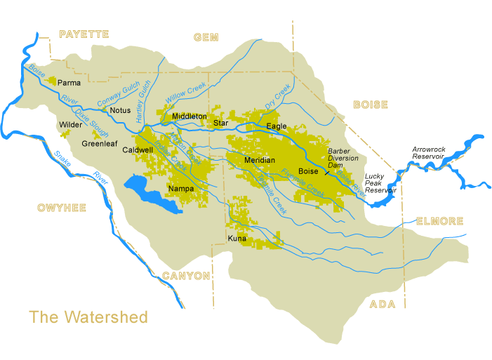
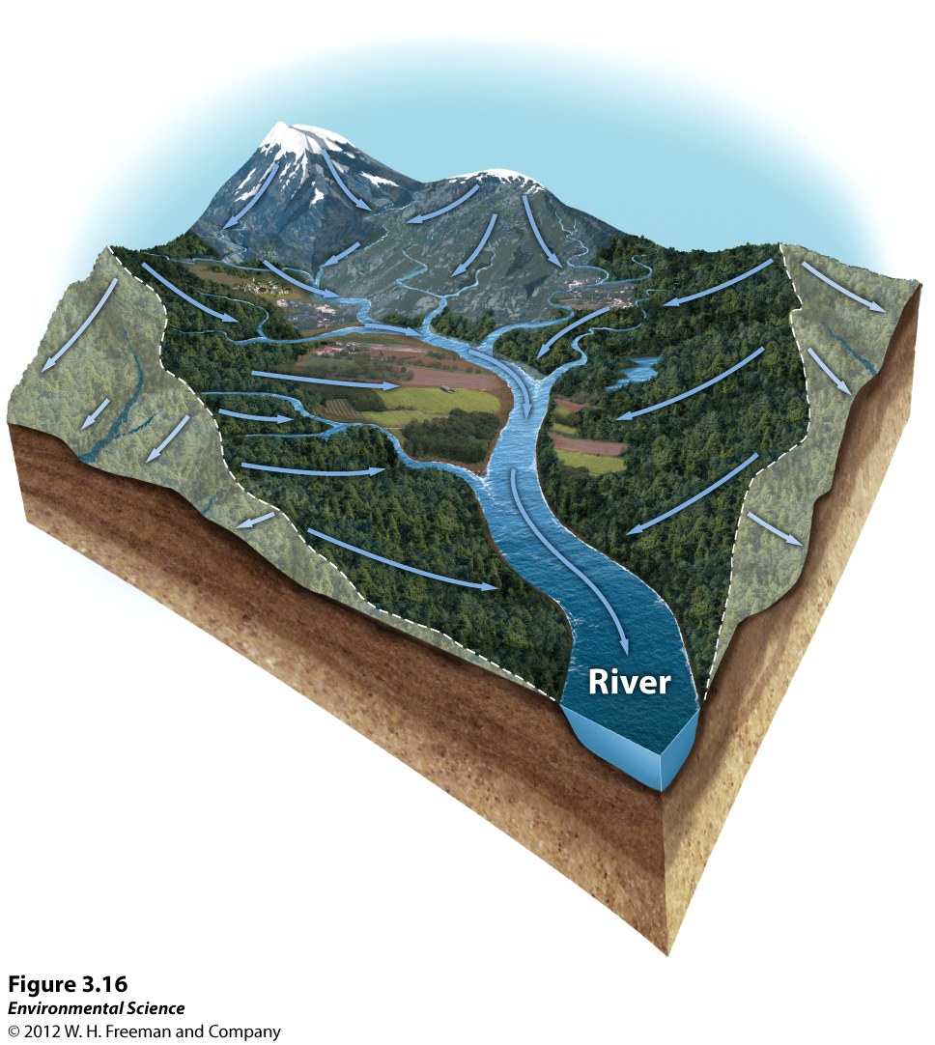
The lower Boise Watershed drains 1,290 square miles of rangeland, forests, agricultural lands, and urban areas. The lower Boise River itself is a 64-mile stretch that originates at Lucky Peak Dam to the east of Boise, and flows northwesterly through Ada and Canyon counties through the cities of Boise, Eagle, and Caldwell, Idaho. The river then flows into the Snake River near Parma, Idaho at the Idaho-Oregon border.

Slide 12
Resistance versus Resilience
Resistance- A measure of how much a disturbance can affect its flows of energy and matter.
Resilience- The rate at which an ecosystem returns to its original state after a disturbance.
Restoration ecology- A new scientific discipline that is interested in restoring damaged ecosystems.

Slide 13
RESILIENCE
Dependant-
specific interactions of the biogeochemical and hydrologic cycles
Species and genetic diversity
Drought
CO₂ concentrations
Pollutants.

Slide 14
The Intermediate Disturbance Hypothesis
The intermediate disturbance hypothesis- states that ecosystems experiencing intermediate levels of disturbance are more diverse than those with high or low disturbance levels.

Slide 15
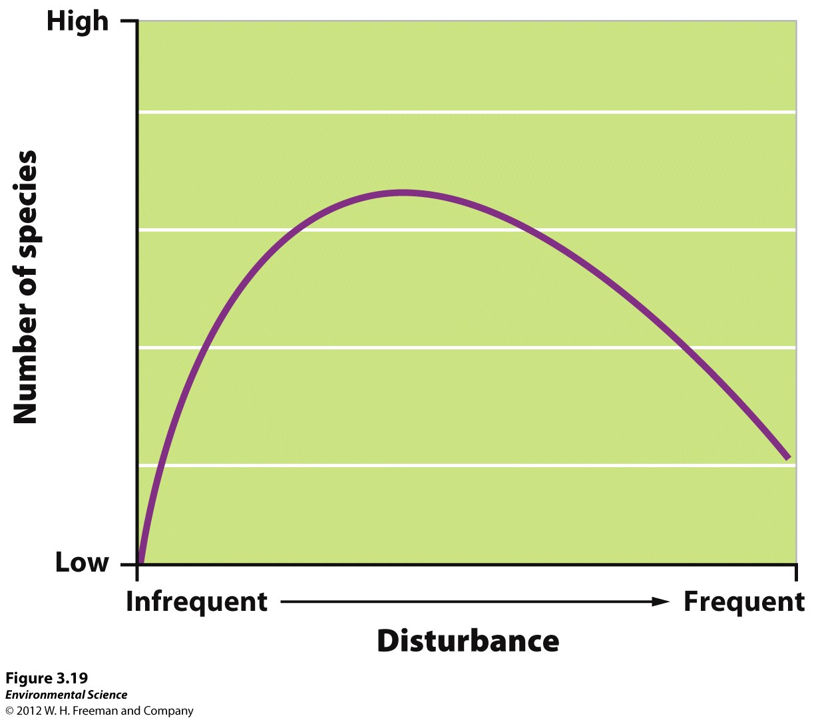

Slide 16
Provisions- Goods that humans can use directly.
Regulating services- The service provided by natural systems that helps regulate environmental conditions.
Support systems- The support services that natural ecosystems provide such as pollination, natural filters and pest control.
Resilience- Resilience of an ecosystem ensures that it will continue to provide benefits to humans. This greatly depends on species diversity.
Cultural services- Ecosystems provide cultural or aesthetic benefits to many people.

