Slide 1
Chapter 4
Global Climates and Biomes

Slide 2
Global Processes Determine Weather and Climate
Weather- the short term conditions of the atmosphere in a local area. These include temperature, humidity, clouds, precipitation, wind speed and atmospheric pressure.
Climate- The average weather that occurs in a given region over a long period- typically several decades.
http://forecast.weather.gov/MapClick.php?lat=43.710610244668146&lon=-116.36499861639231#.Vhrn4flViko
http://www.usairnet.com/weather/maps/current/barometric-pressure/

Slide 3
Processes that affect the distribution of heat and precipitation
Unequal heating of Earth by the sun
Atmospheric convection currents
The rotation of the Earth
Earth’s orbit around the Sun on a tilted axis
Ocean currents

Slide 4
Earth's Atmosphere
Troposphere- the layer closest to Earth's surface extending roughly 16 km (10 miles) above Earth.
Densest layer
Nitrogen, Oxygen, and water vapor
Characterized by
Circulation and mixing of gases and liquids
Earth’s weather occurs HERE!!!

Slide 5
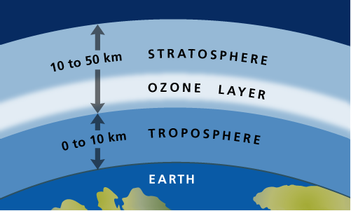
Earth's Atmosphere
Stratosphere- above the troposphere, this extends from roughly 16 to 50 km (10-31 miles).
Less dense
Ozone O₃
Absorbs most of the UV-B radiation and all of the UV –C radiation

Slide 6
Earth's Atmosphere
Mesosphere
Thermosphere
ability to block harmful X-ray and UV radiation
Northern lights/aurora borealis
Charged gas particles glow and produce lights when hit by solar radiation
Driven by magnetic forces
Farthest is the Exosphere

Slide 7
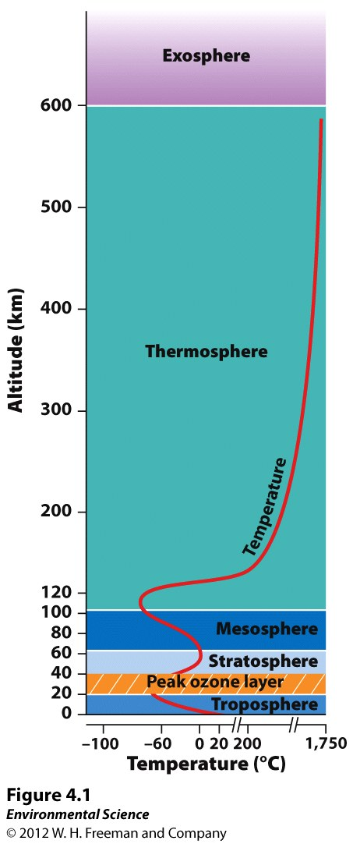
Troposphere
Stratosphere
Mesosphere
Thermosphere
Exosphere

Slide 8
Unequal Heating of Earth
As the Sun's energy passes through the atmosphere and strikes land and water, it warms the surface of Earth. But this warming does not occur evenly across the planet.

Slide 9
Unequal Heating of Earth
This unequal heating is because:
The variation in angle at which the Sun's rays strike
The amount of surface area over which the Sun's rays are distributed
Some areas of Earth reflect more solar energy than others. (Albedo)

Slide 10
Differential Heating of the Earth

Slide 11
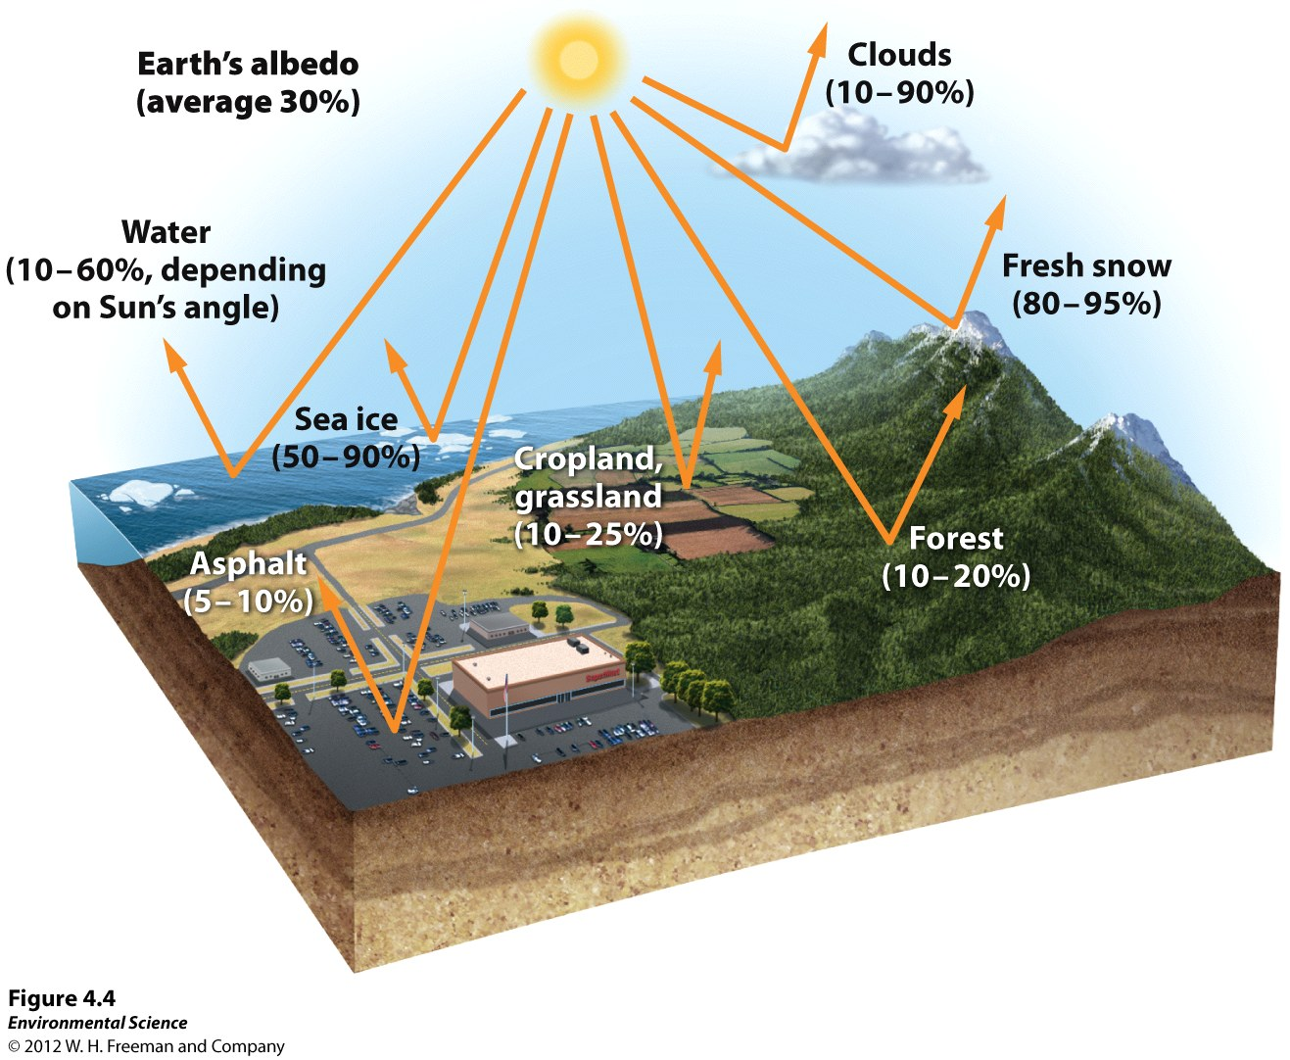

Slide 12
Atmospheric Convection Currents
Air has four properties that determines its movement:
Density- less dense air rises, denser air sinks.
Water vapor capacity- warm air has a higher capacity for water vapor than cold air.
Adiabatic heating or cooling- as air rises in the atmosphere its pressure decreases and the air expands. Conversely, as air sinks, the pressure increases and the air decreases in volume.
Latent heat release- when water vapor in the atmosphere condenses into liquid water and energy is released.

Slide 13
Atmospheric Convection Currents
Density- less dense air rises, denser air sinks.
Water vapor capacity- warm air has a higher capacity for water vapor than cold air.

Slide 14
Formation of Convection Currents
Atmospheric convection currents are global patterns of air movement that are initiated by the unequal heating of Earth.
Hadley cells- the convection currents that cycle between the equator and 30˚ north and south.
Intertropical convergence- the area of Earth that receives the most intense sunlight and where the ascending branches of the two Hadley cells converge.
Polar cells- the convection currents that are formed by air that rises at 60˚ north and south and sinks at the poles (90˚ north and south)

Slide 15
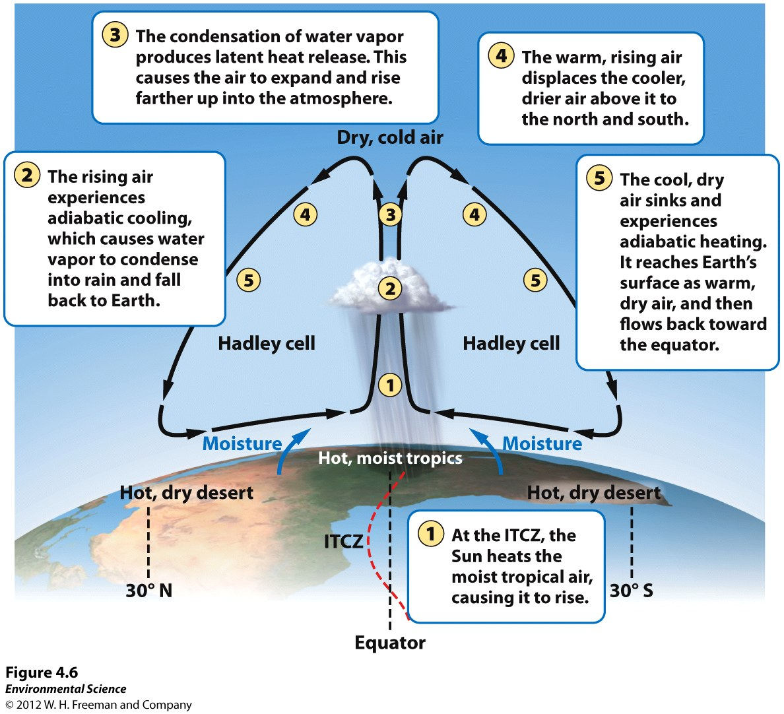
Formation of Convection Currents

Slide 17
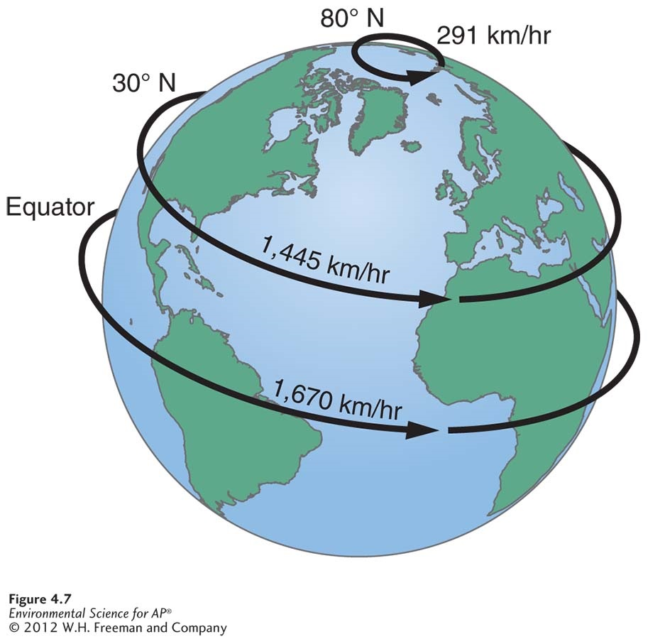
Earth's Rotation and the Coriolis Effect
As Earth rotates, its surface moves much faster at the equator than in mid-latitude and polar regions.
The faster rotation speeds closer to the equator cause a deflection of objects that are moving directly north or south.

Slide 18
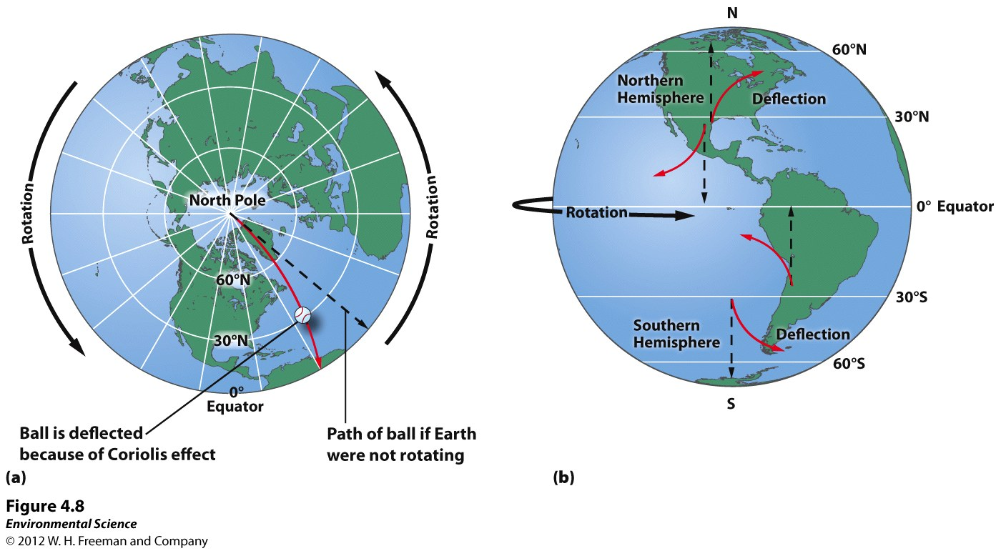
http://www.classzone.com/books/earth_science/terc/content/visualizations/es1904/es1904page01.cfm

Slide 19
Earth's Rotation and the Coriolis Effect
Coriolis Effect- the deflection of an object's path due to Earth's rotation.
The prevailing winds of the world are produced by a combination of atmospheric convection currents and the Coriolis effect.
https://www.youtube.com/watch?v=i2mec3vgeaI

Slide 20
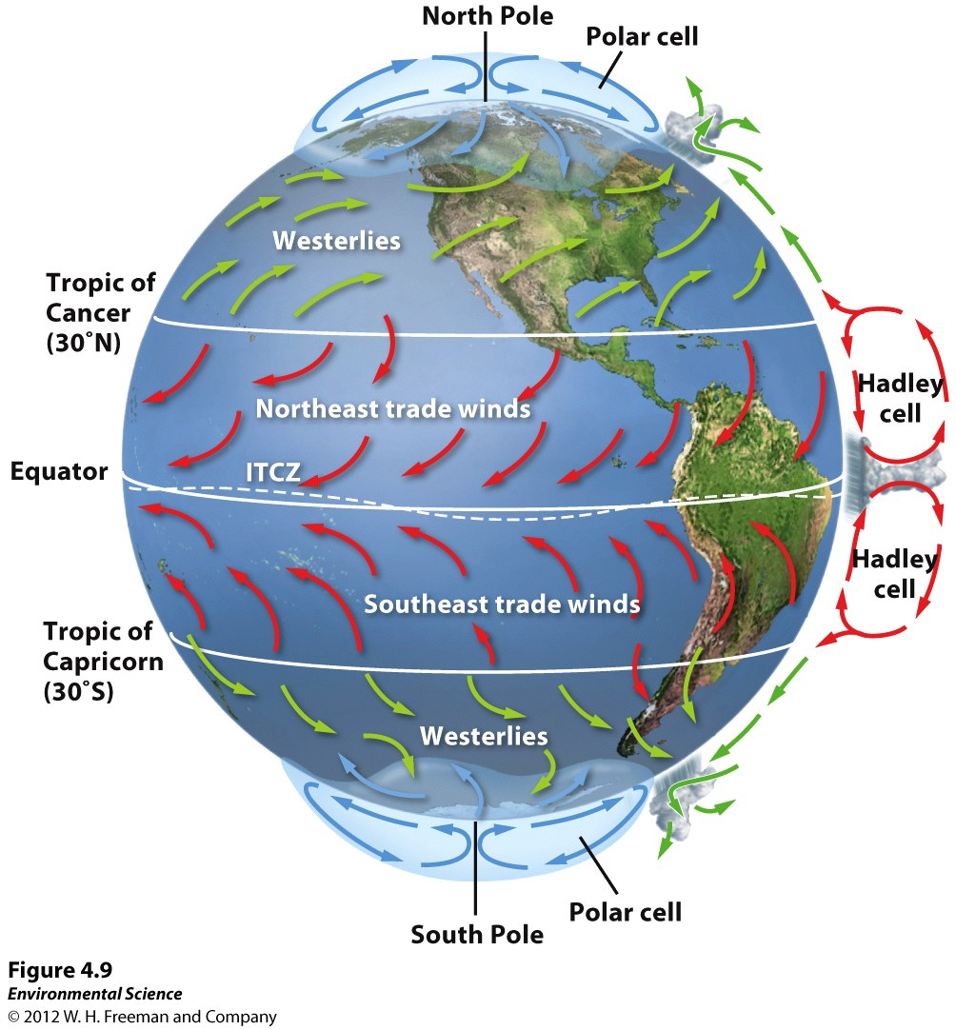

Slide 21
Earth's Tilt and the Seasons
The Earth's axis of rotation is tilted 23.5 ˚.
When the Northern Hemisphere is tilted toward the Sun, the Southern Hemisphere is tilted away from the Sun, and vice versa.

Slide 22
