Slide 1
Describe the energy consumption in the US since 1850

Slide 2
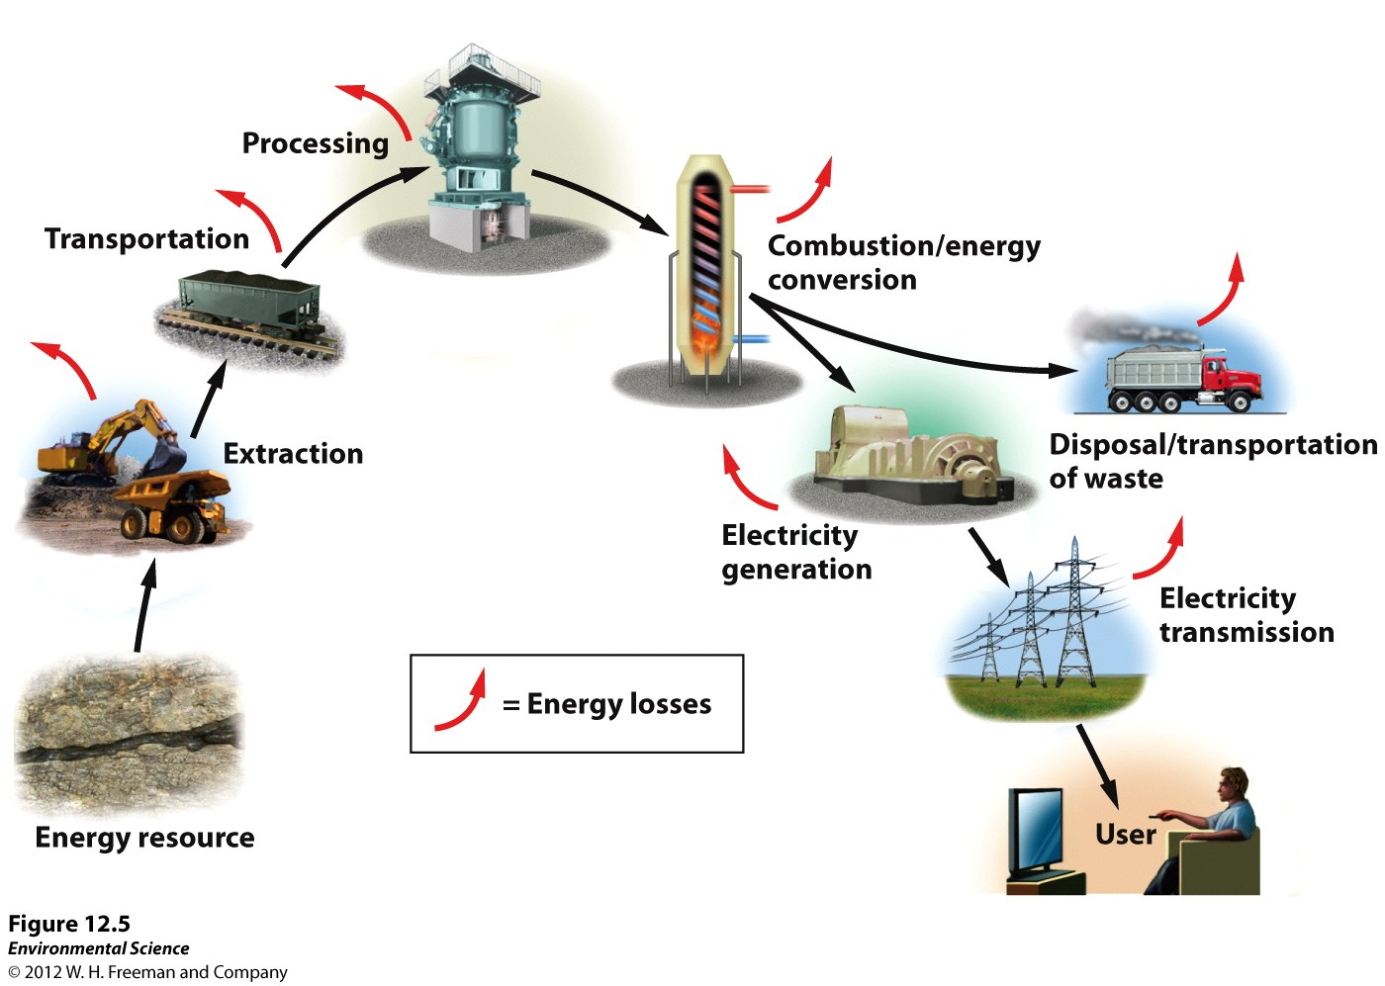
Process of Energy Use
There is energy loss at each stage of the process
Converting coal into electricity is approximately 35% efficient
Can be up to 50%
Hydroelectric – 90%

Slide 3
Process of Energy Use
Energy efficiency includes:
Efficiency of the process of obtaining the fuel
Efficiency of the process that converts it to work that is needed
Many opportunities for energy loss reduces energy efficiency
EROEI ( energy return on energy investment)
The larger the EROEI number the more desirable/more efficient
EROEI = Energy obtained from fuel
Energy invested to get fuel

Slide 4
Electricity Generation
The burning fuel from coal transfers energy to water, which becomes steam.
The kinetic energy contained within the steam is transferred to the blades of a turbine, a large device that resembles a fan.
As the energy in the steam turns the turbine, the shaft in the center of the turbine turns the generator.
This mechanical motion generates energy.
https://www.youtube.com/watch?v=e_CcrgKLyzc

Slide 5
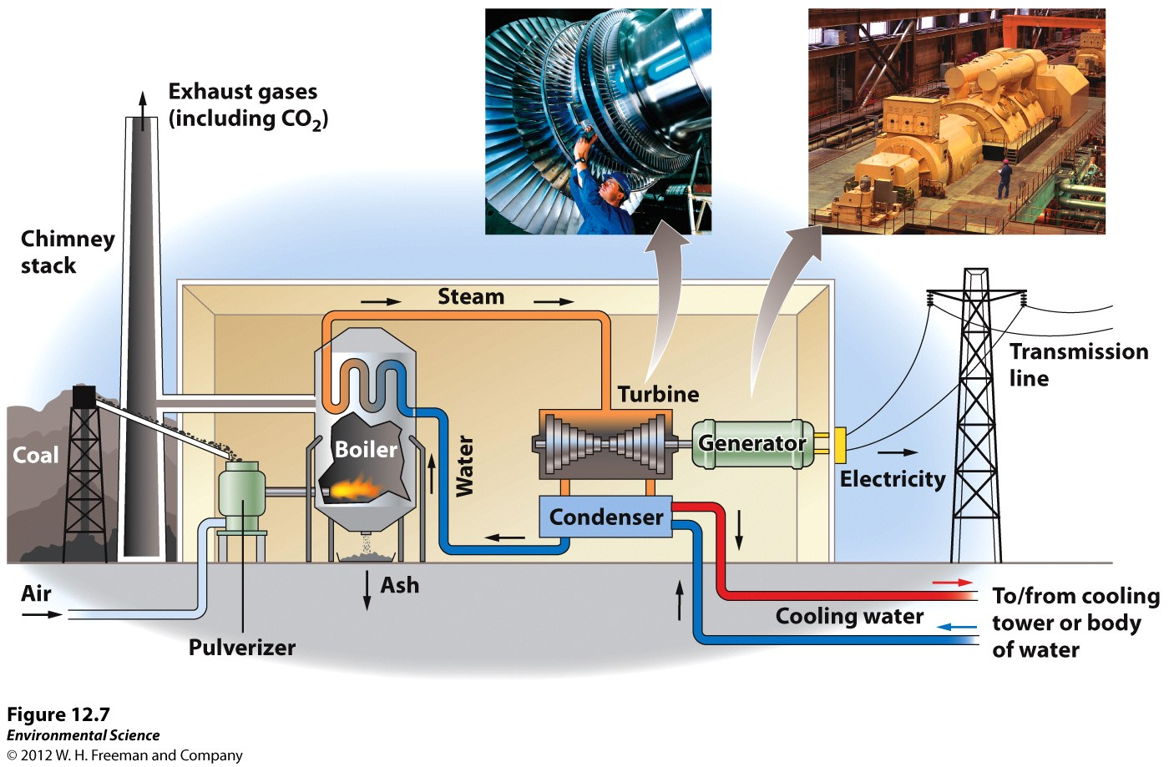
Electricity Generation

Slide 6
Coal
Solid fuel formed from the remains of trees, ferns, and other plant materials that were preserved 280-350 million years ago
Peat is the precursor to coal
lignite, sub-bituminous, bituminous, and anthracite
The US mostly uses Subbituminous and Bituminous for electricity generation
Largest coal reserves
U.S., Russia, China and India
Largest producers
China, the United States, India, and Australia

Slide 7
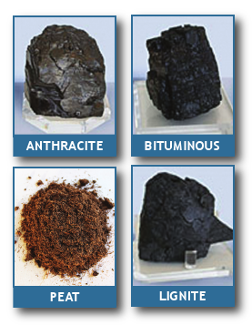
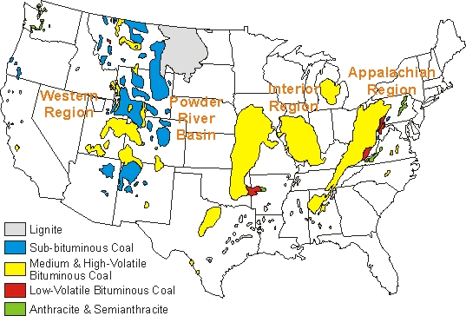
Coal mining
https://www.youtube.com/watch?v=Joo90ZWrUkU
https://www.youtube.com/watch?v=FA3Royf9_zM
https://www.youtube.com/watch?v=KnnHprUGKF0

Slide 8
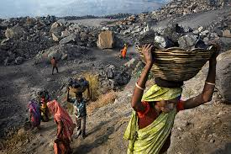
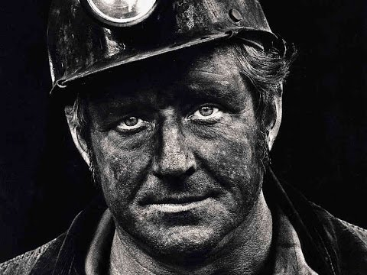
Coal
Advantages
Disadvantages
Surface mining - cheap and easy
Easy fuel- handling, little refining, transportation
Impurities – sulfur, trace metals : Mercury, lead, and arsenic
Combustion releases toxic pollutants into air
Produces ash ( 3-20%)
Carbon dioxide produced

Slide 9
Idaho Power
https://www.idahopower.com/AboutUs/EnergySources/FuelMix/resourcePortfolio_2015.cfm
Hydroelectric and coal
Service area –parts of eastern Oregon, I84 corridor, Pocatello, and around Salmon

Slide 10
Natural Gas- nonrenewable
80-95% methane (CH4) and 5-20% ethane, propane, and butane
Electricity generation and industrial processes
Used for in the processing of plastic, fertilizer, anti-freeze, and fabrics
Residential use

Slide 11
METHANE

Slide 12
Methane (Natural Gas) -renewable
Trash decomposes (or rots) in landfills, creating methane gas.
Methane rises to the top of the landfill and is collected in pipes.
The methane is burned to produce heat or generate electricity

Slide 13
A lactating dairy cow can produce more than 100 pounds of manure a day. Handling that manure properly is a major expense for dairy farmers, and can result in air and water pollution. Methane digesters that turn the poop into power can also help improve dairy air and water quality.

Slide 14
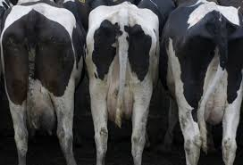
Manure Math!
If an animal produces 60 L of manure each day and the average number of animals on a feeding operation is 460 cattle, how much manure is produced each day?
Each week?
A year?
Scientific notation!

Slide 15
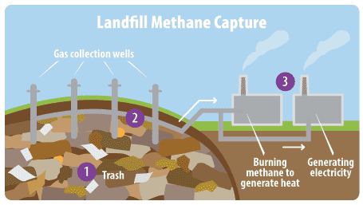
https://www.youtube.com/watch?v=ASoXPy8RWlQ

Slide 16
The Future of Fossil Fuel Use
If current global use continues, we will run out of conventional oil in less than 40 years.
Coal supplies will last for at least 200 years, and probably much longer.

Slide 17
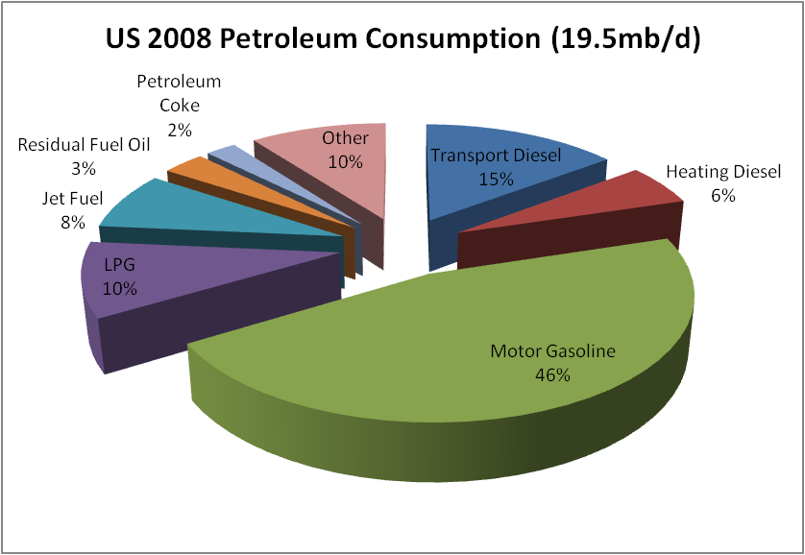
Petroleum
Fossil fuel – mixture of hydrocarbons, water and sulfur
Crude oil, oil and petroleum – equivalent substances
In 2016, the United States consumed a total of 7.21 billion barrels of petroleum products, an average of about 19.69 million barrels per day.
Average U.S. citizen uses 2 barrels a month

Slide 18
Migratory bird act and energy
Migratory bird act (1918)- makes it illegal to “pursue, hunt, take, [or] capture” migratory birds without a permit
the dispute centers largely on how to interpret “take.”
power lines kill up to 64 million birds a year.
Communications towers are estimated to kill up to 7 million birds per year, and uncovered oil waste pits account for up to another 500,000 to 1 million bird deaths every year.
Data on wind turbines are harder to come by, but current estimates are approximately 234,000 bird deaths a year
holds industries accountable for bird deaths. These proposals would prevent enforcement of “incidental” bird deaths, removing incentives for companies to adopt practices that protect birds from threats such as oil waste pits, and eliminating penalties for companies that kill substantial numbers of birds, including from large oil spills.
The Interior Department has rolled back an policy aimed at protecting migratory birds, stating that it will no longer prosecute oil and gas, wind, and solar operators that accidentally kill birds.
BP- estimated- more than 82,000 birds may have been harmed by the spill.

Slide 19
ANWR- Arctic National Wildlife Refuge
the largest area of untouched wilderness in the United States
protects intact ecosystems and vibrant arctic life.
Located in the northeast corner of Alaska, it is the only refuge specifically designed for wilderness purposes.
It's habitats range from boreal forests, north over the Brooks Range, to sweep across rivers, tundra, lakes, wetlands to coastal lagoons, barrier lands and bays of the Arctic Ocean.
Rich diversity of over 250 species of wildlife and the Gwich'in and Inupiat people.
Its spiritual, recreational, aesthetic, historical, cultural, and scientific values make the Arctic Refuge a place worth protecting with the strongest possible measures

Slide 20
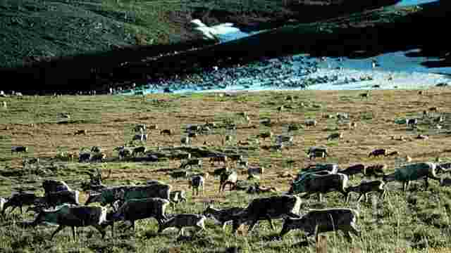
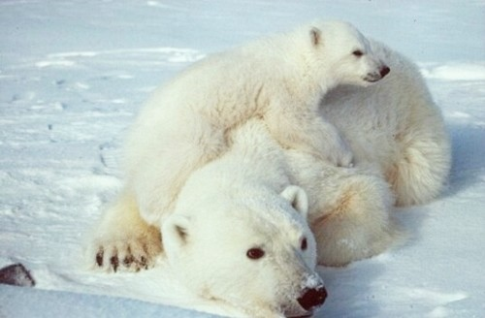
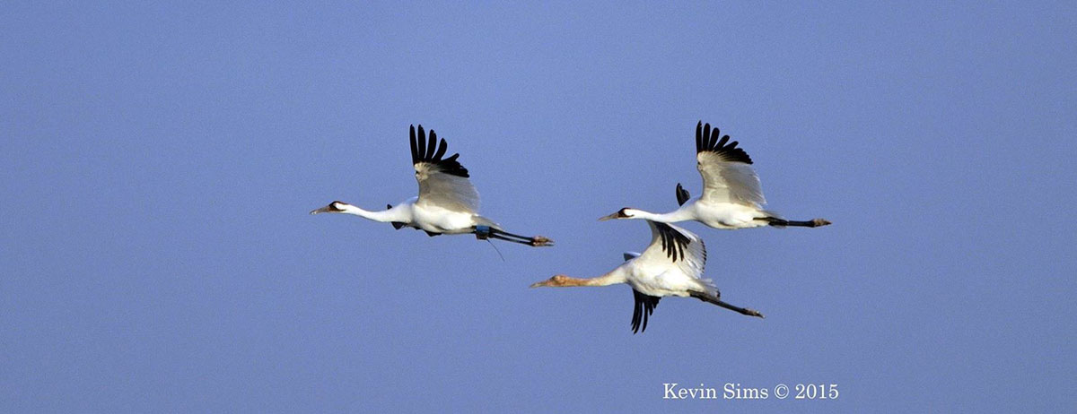

Slide 21
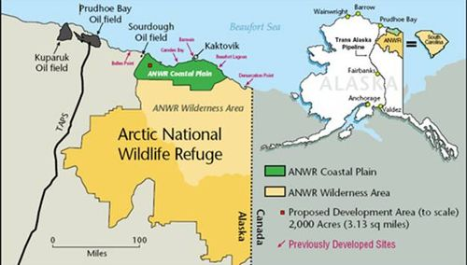
ANWR- Arctic National Wildlife Refuge
7.7 million hectare (19 million acre) tract of land in northeastern Alaska
Area 1002 - 1.5-million-acre part of the coastal plain
DOI estimates that “in-place resources” range from 4.8 billion to 29.4 billion barrels of oil.
Senate Budget Committee passed a bill allowing oil and natural gas drilling in Alaska's pristine ANWR

Slide 22
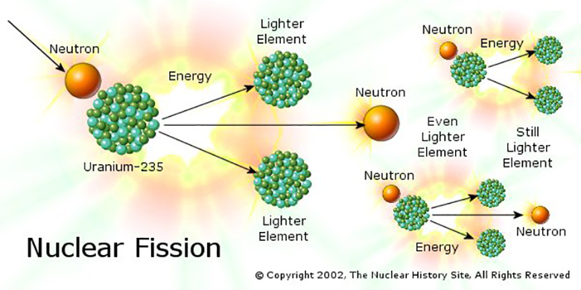
Nuclear Energy
Fission- a nuclear reaction in which a neutron strikes a relatively large atomic nucleus, which then splits into two or more parts.
http://www.pbs.org/wgbh/nova/education/physics/fission-chain-reaction.html

Slide 23
Nuclear Reactors
Fuel rods- the cylindrical tubes that house the nuclear fuel used in a nuclear power plant.
Nuclear power plants work by using heat from nuclear fission to heat water. This water produces the steam to turn the turbine, which turns a generator.
Control rods- cylindrical devices that can be inserted between the fuel rods to absorb excess neutrons, thus slowing or stopping the fission reaction.

Slide 24
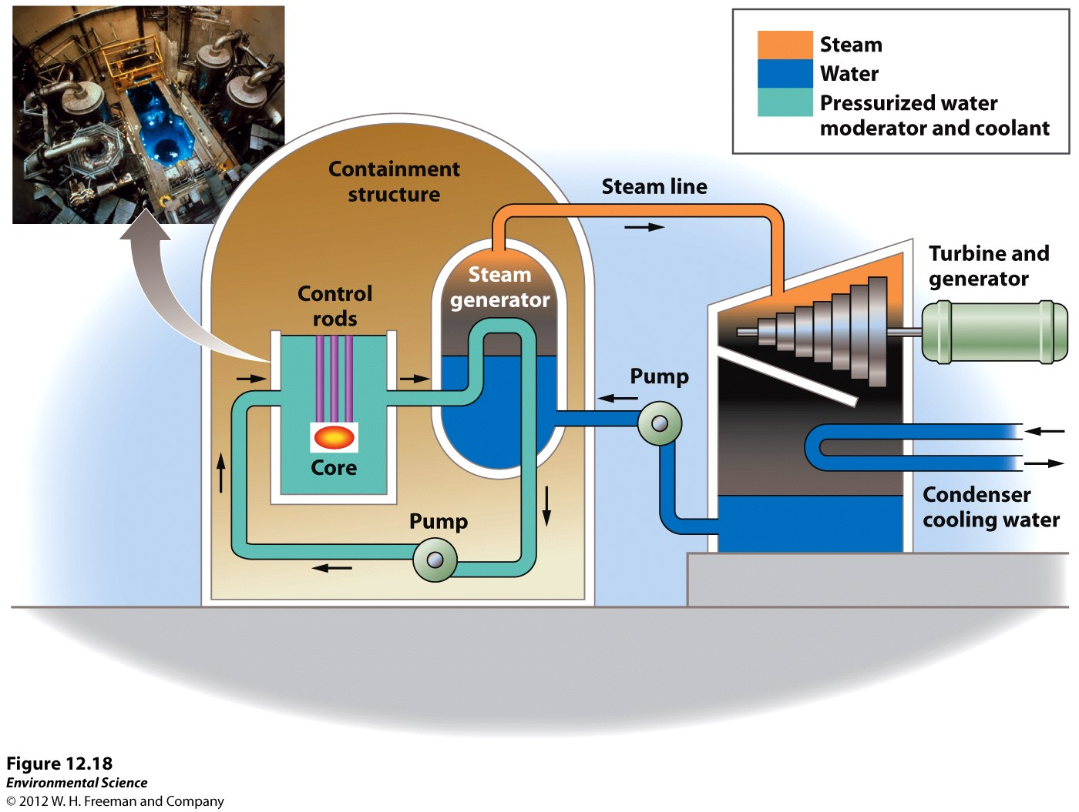
Nuclear Reactors

Slide 25
Advantages and Disadvantages of Nuclear Energy
Advantages | Disadvantages
No air pollution is produced | Possibility of accidents
Countries can limit their need for imported oil | Disposal of the radioactive waste

Slide 26
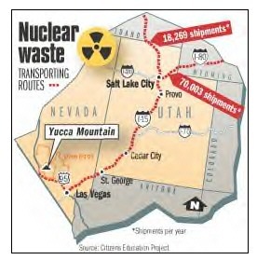
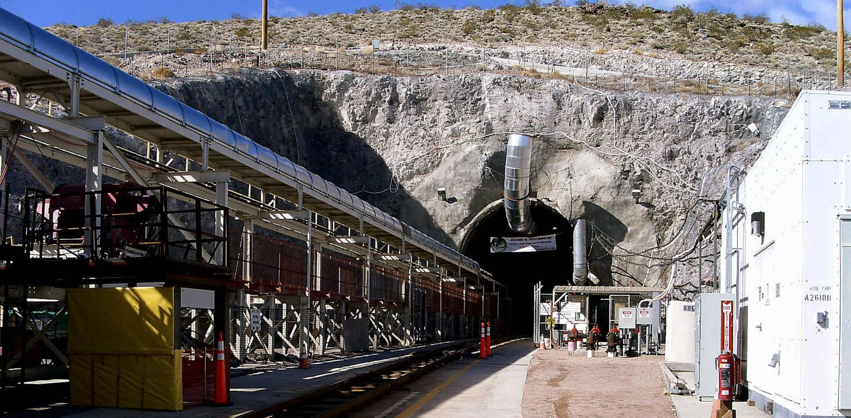
Radioactive Waste
Radioactive waste- once the nuclear fuel can not produce enough heat to be used in a power plant but it continues to emit radioactivity.
This waste must be stored in special, highly secure locations because of the danger to living organisms.

Slide 27
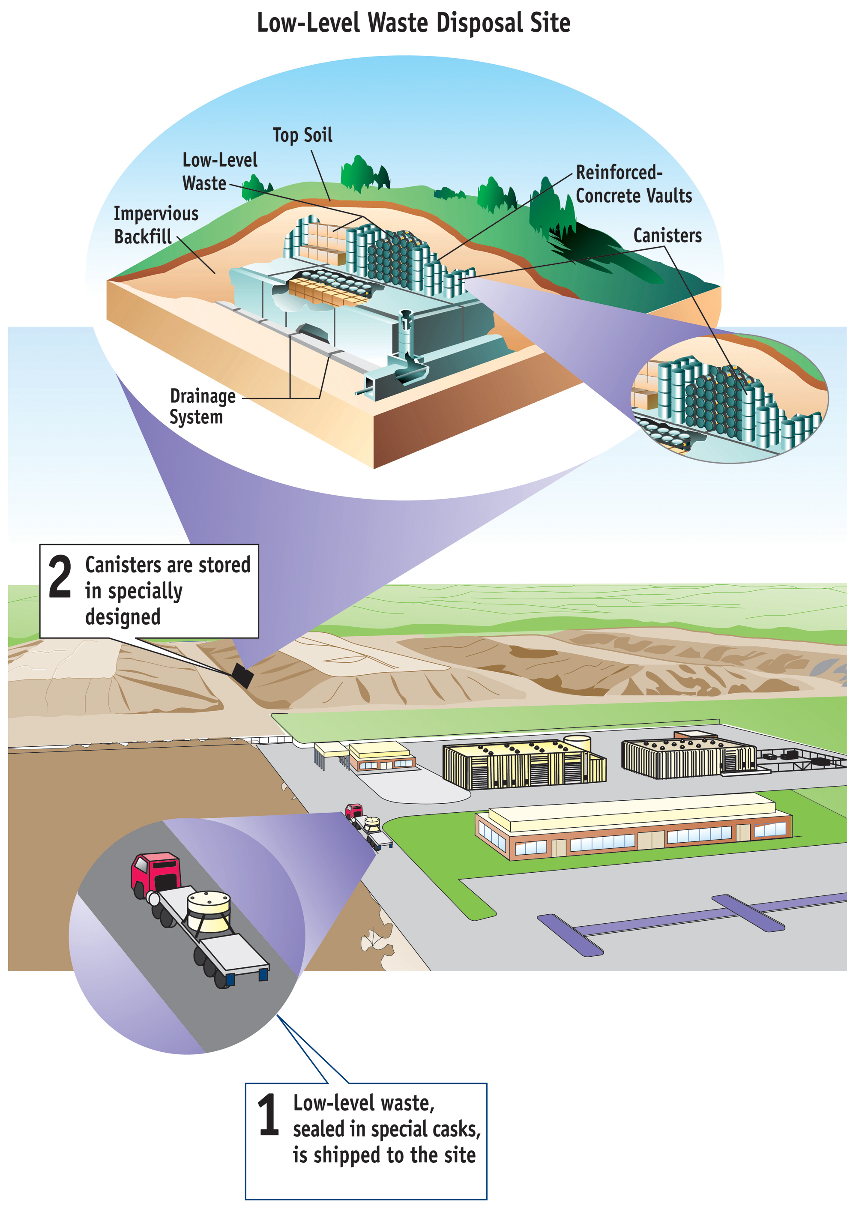
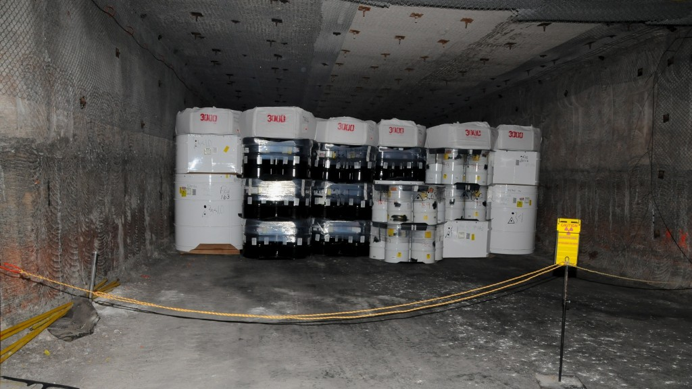

Slide 28
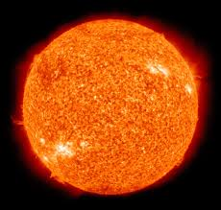
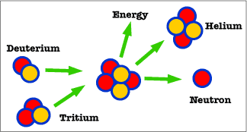
Fusion
Nuclear fusion- the reaction that powers the Sun and other stars. This occurs when lighter nuclei are forced together to produce heavier nuclei and heat is released.
Fusion is a promising, unlimited source of energy in the future, but so far scientists have had difficulty containing the heat that is produced.

Slide 29
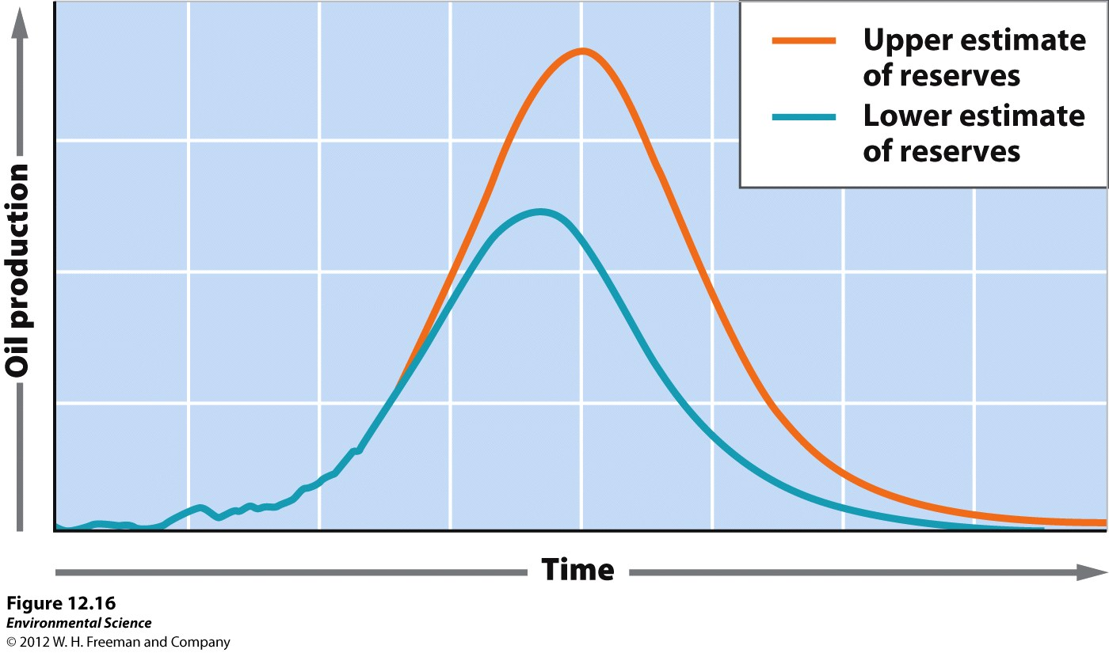
Hubbert curve- a graph that shows the point at which world oil production would reach a maximum and the point at which we would run out of oil.
The Hubbert Curve

