Slide 1
Plate Tectonics

Slide 3
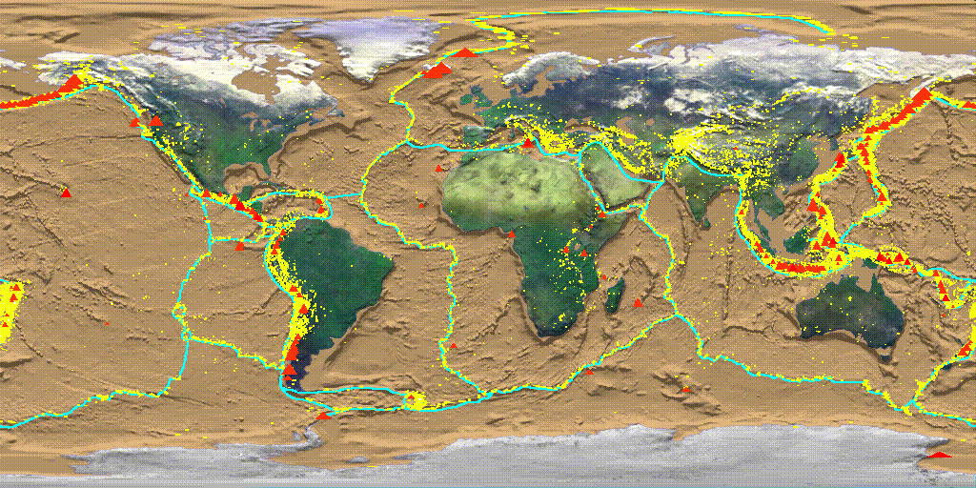
What is it?
Theory to explain The movements of the Earth’s lithosphere that has formed the earth’s surface features.

Slide 4
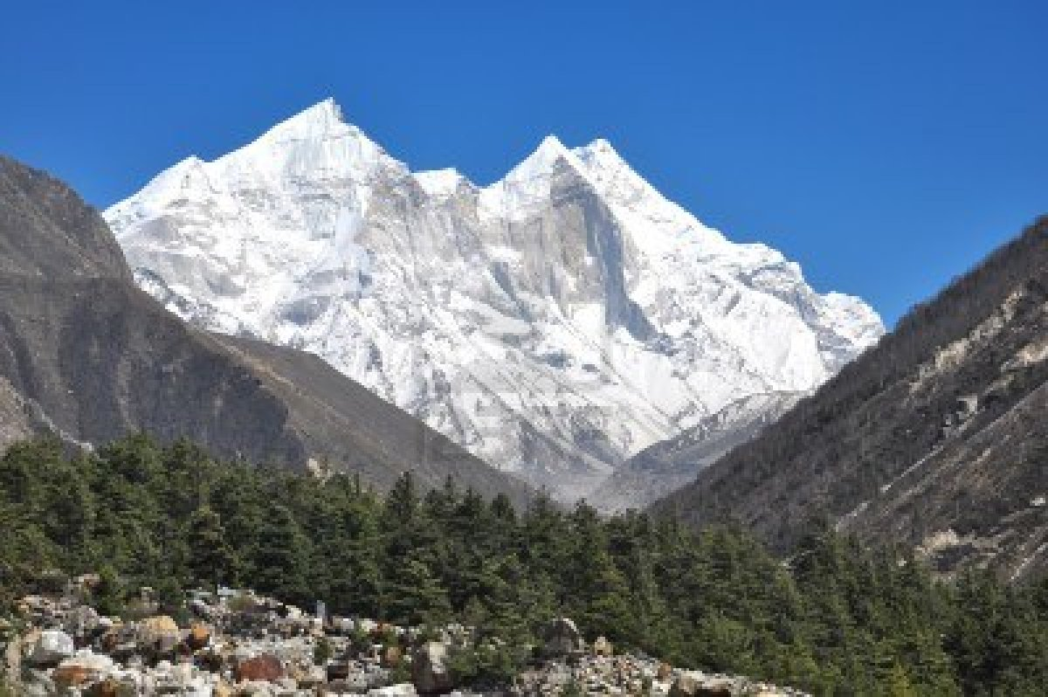
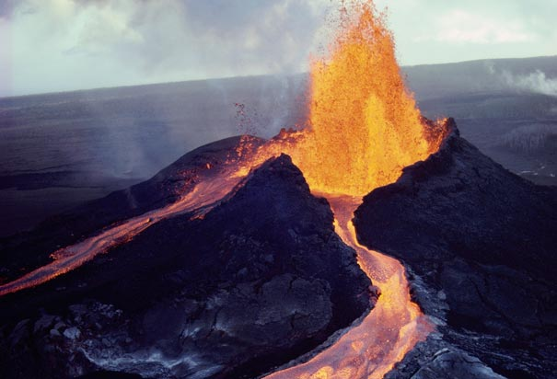

Slide 5
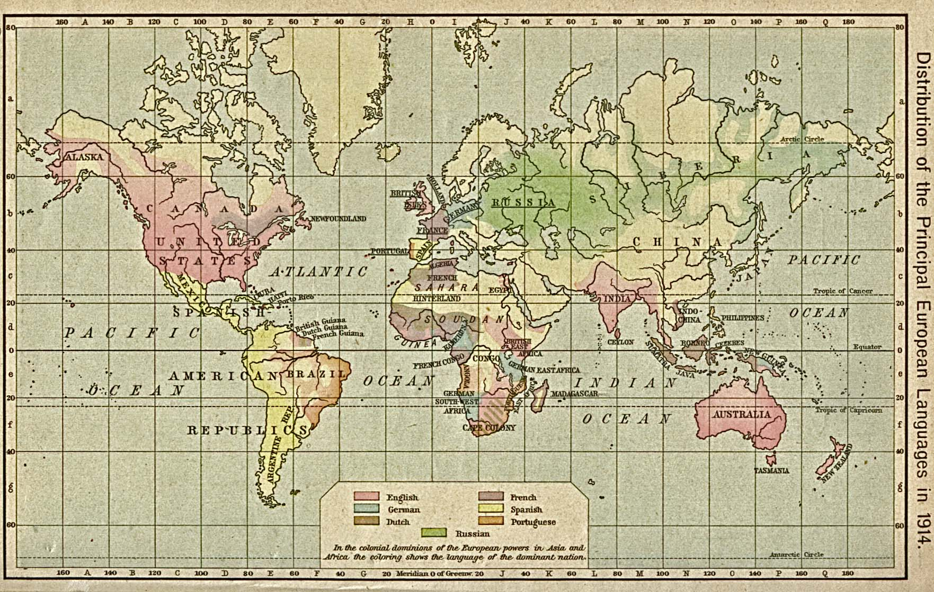
History of a Theory
As world maps became complete and more accurate, observant individuals were intrigued by the shapes of the continents on either side of the Atlantic Ocean

Slide 6
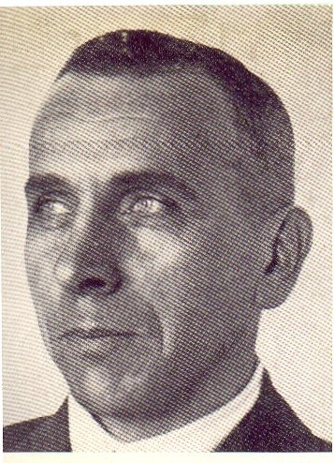
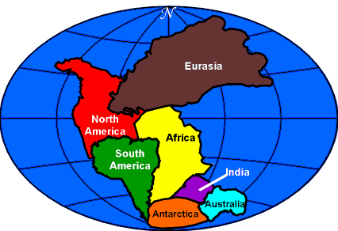
Alfred Wegener
Came up with the idea of continental drift, and that the continents where once one big continent. (1912)
Pangaea

Slide 7
Theory
Evidence to support????
Jigsaw puzzle
Rock formations
Fossils
Climate

Slide 8
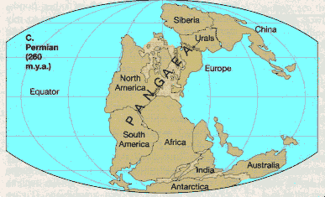
Jigsaw puzzle – when the continents were moved back together their edges matched up like a jigsaw puzzle.

Slide 9
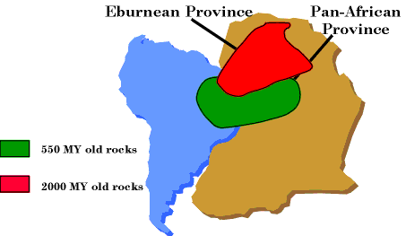
Rock formations – mountain ranges and coal fields line up when the continents are moved back together.
Mountain range in south Africa lines up with a range in Argentina.
European coal fields line up with coal fields in North America

Slide 10
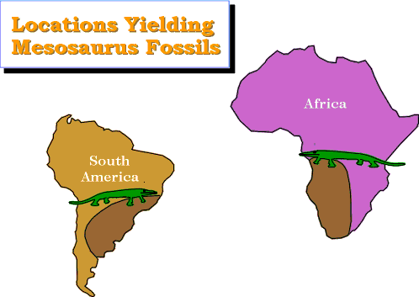
Fossils – non-aquatic animals and plant fossils have been found on continents separated by water.

Slide 11
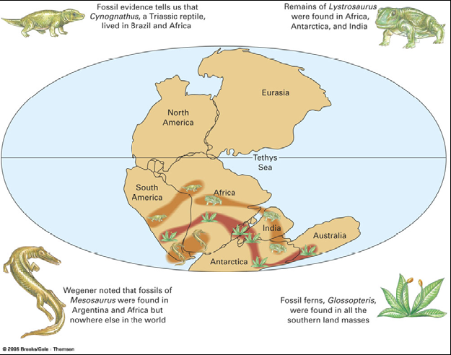

Slide 12
Climate
Evidence From Climate
Spitsbergen, an island in the Arctic Ocean
Presently covered in ice
Presently has 300 million year old fossilized tropical plants.
South Africa, the hot desert place
Evidence of glacier activity in the rock bed
Wegener realized that the Earth’s climate has definitely shifted, or the location of the continents have moved, and brought with them the fossilized evidence.

Slide 13
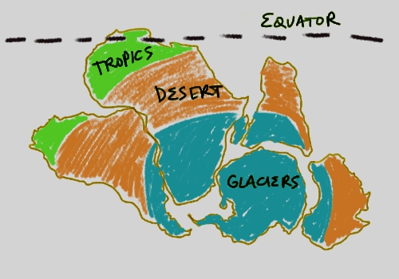
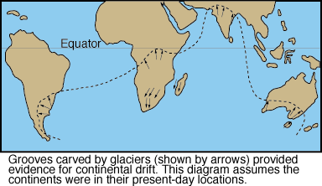

Slide 14
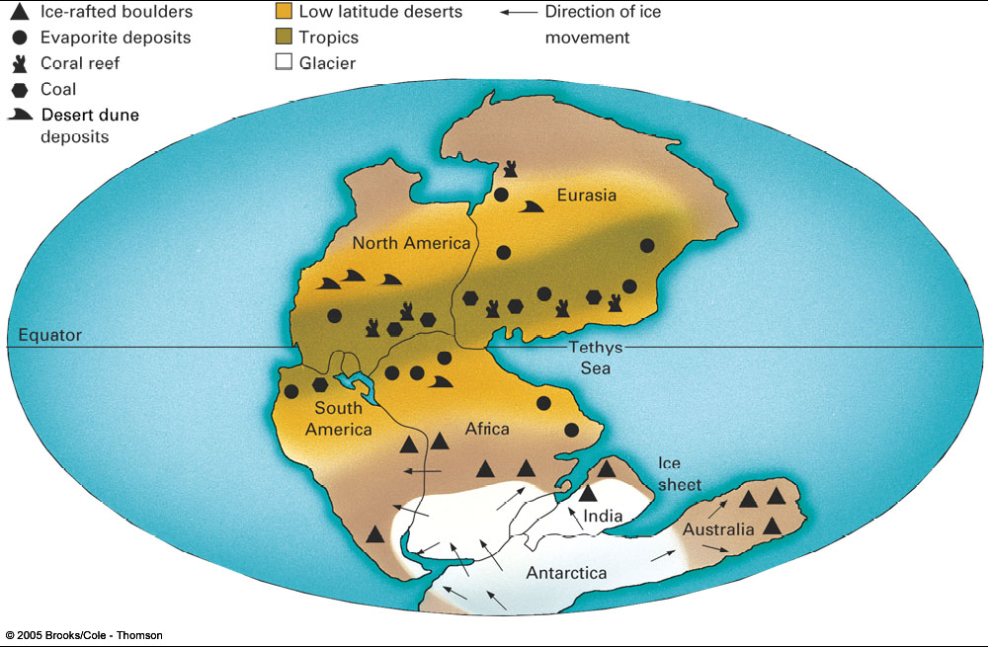

Slide 15
It all added up.
Too many questions all got answered by with one theory.
Wagner had to tell it like he saw it.
The continents used to be in entirely different position. All together, in one super continent.
Pangaea

Slide 16
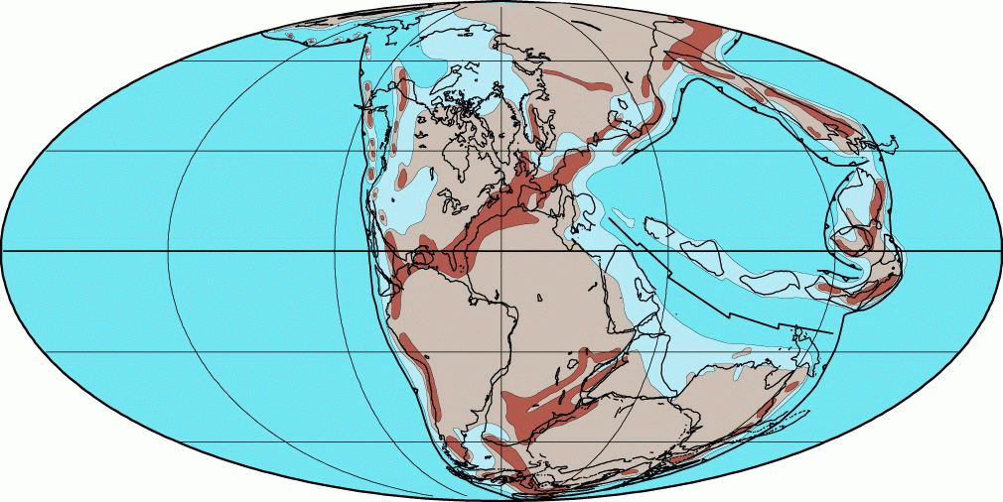
Wegener’s Pangaea

Slide 17
Wegener went public
Told his friends, they didn’t get it.
Told his colleagues, they wanted more information
Wrote a book “The Origins of Continents and Oceans”.
Want to know what happened to Wegener and his ideas?

Slide 18
They got thrown out!!!
Flat rejected!!
He was told he was wrong…

Slide 19
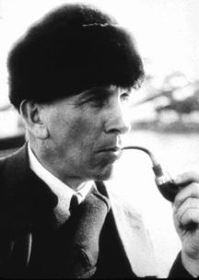
The Big Hole
Wegener’s theory did not propose a mechanism that would allow the continents to move through the sea floor without being ripped apart.
Only a few people supported Wegener’s ideas. Wegener kept looking for evidence.
He died in 1930 with out the support of the scientific community.
http://www.youtube.com/watch?v=T1-cES1Ekto

Slide 20
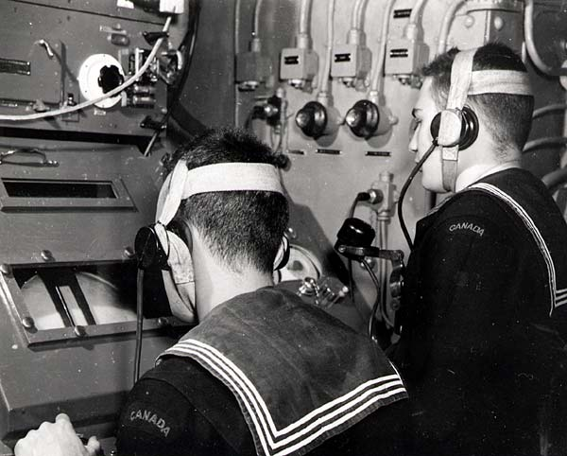
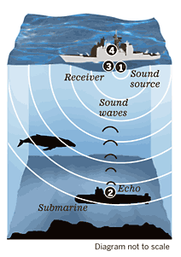
WAR II
War broke out in mid 1900’s, big war.
Germans had the U-Boat.
We needed to find them
Developed Sonar
How does Sonar work?
The navy started to map the ocean floor.
Scientists started paying attention.

Slide 21
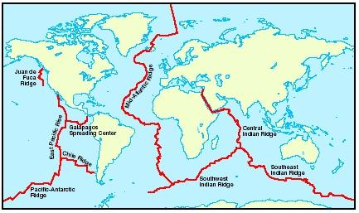
Mid Ocean Ridge
Worlds longest mountain range.
Scientists wanted to know what it was

Slide 22
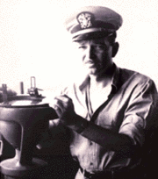
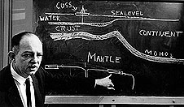
Harry Hess
American scientist who studied the Mid Ocean Ridge
Born 1906
Captain of the assault transport Cape Johnson during World War II
Princeton's Geology Department
Died in 1969

Slide 23
Harry Hess – Sea Floor Spreading
Noticed the ridge had a pattern to it.
Thought about Wegener’s ideas
Maybe he was right? Nah, couldn’t be could it?
Hess proposes sea-floor spreading 1960
Says the Sea floor is a conveyer belt that carries the continents.
At the mid ocean ridge, molten lava rises from the mantle and erupts.
Adds new rock to the center of the ridge, pushing the old stuff aside.

Slide 24
Evidence to support Sea Floor Spreading
Sonar topographic map of the sea floor.
Molten Material
They found evidence of molten rock cooling quickly when it became solid rock.

Slide 25
Evidence to support Sea Floor Spreading
Drilling samples
Used a boat, the Glomar Challenger, to drill pieces of the ocean floor
Found that the farther they got from the ridge the older the rock was

Slide 26
Evidence to support Sea Floor Spreading
Magnetic Stripes
Earths magnetic pole flip every now and then.
Minerals in molten rock align with the magnetic field
When it sets up, it stays pointing one direction
We can measure that.
When looking a the magnetic material we can see a pattern

Slide 27
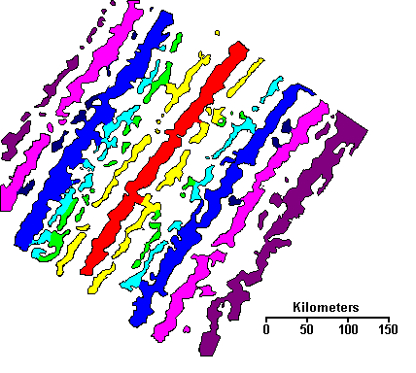
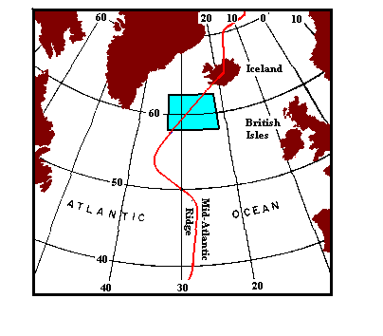
Evidence to support Sea Floor Spreading
Magnetic Stripes

Slide 28
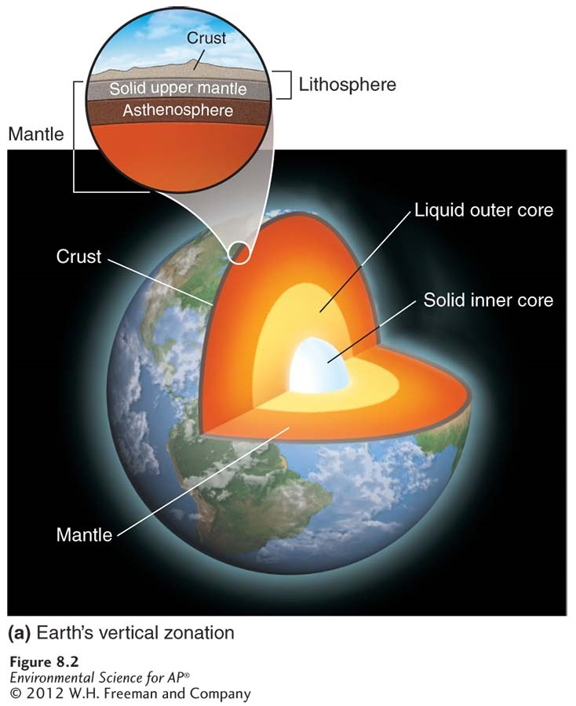
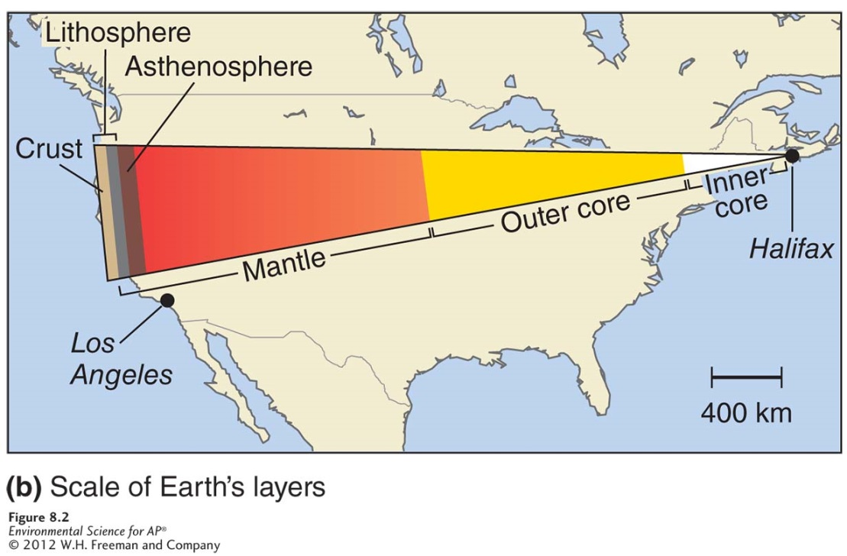

Slide 29
Earth's Layers
Lithosphere
Asthenosphere
Mesosphere
Outer core
Inner core

Slide 31
The Earth’s Layers
Asthenosphere- the outer part of the mantle, composed of semi-molten rock.
Lithosphere- the brittle outermost layer of the planet that is approximately 100 km thick.

Slide 32
Faults and Earthquakes
Fault zone- large expanses of rock where movement has occurred.
Epicenter- the exact point on the surface of Earth directly above the location where the rock ruptures.
Richter scale- a measure of the largest ground movement that occurs during an earthquake. The scale increases by a factor of 10, so an earthquake of 7 is 10 times greater than an earthquake of 6.

Slide 33
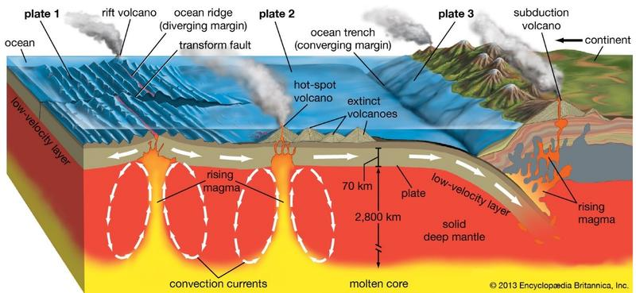
So…
What happens to the Sea floor? Where does it go?
200 Million Yr. Cycle.

Slide 34
https://www.youtube.com/watch?v=ha-uagjJQ9k

Slide 35
Density stratification
Highest density material at center (core)
Lowest density material at surface (crust)
Earth layers (stratification)
Gravitational separation
Heavy metals-
Iron Nickel
Lighter materials-
Rocky materials

Slide 36
Chemical composition
Crust
Low-density, mainly silicate minerals
Mantle
Mainly Fe and Mg silicate minerals
Core
High-density, mainly Fe and Ni

Slide 37
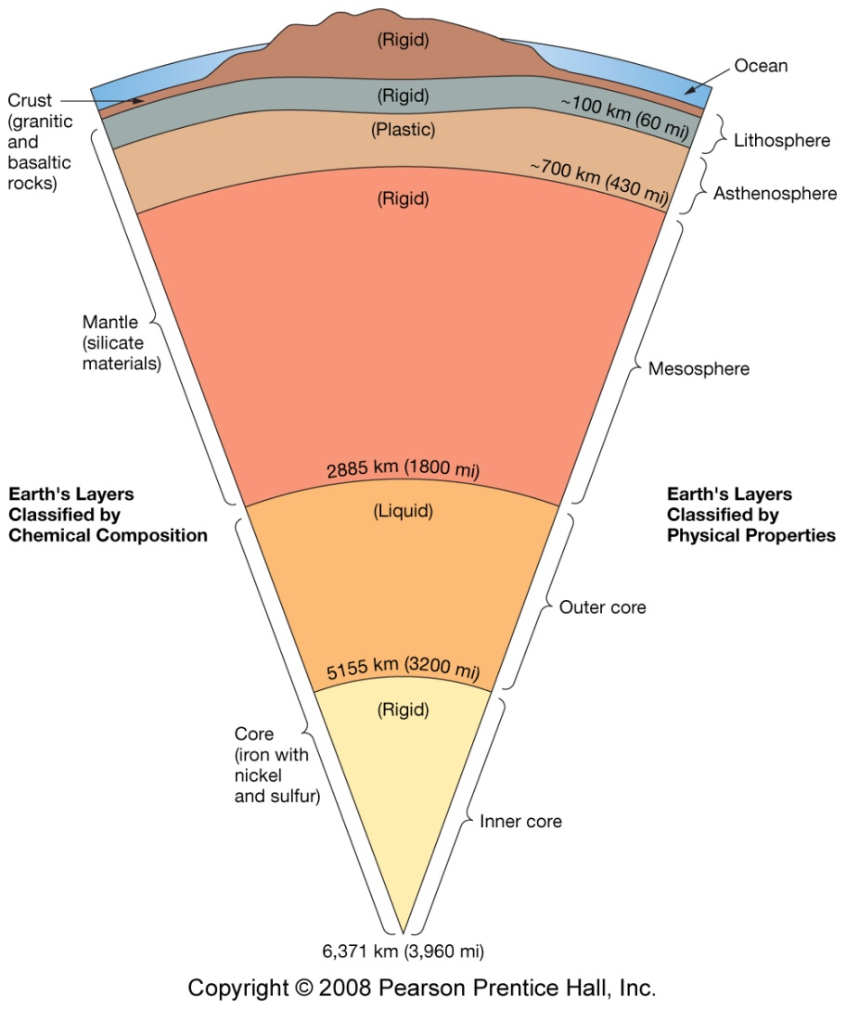
Physical Properties
Crust
Cool, rigid
Ranges from 4 - 60 km (2.5 – 37 mi.)
Lithosphere
Cool, rigid, brittle
Surface to about 100 km (62 miles)
Asthenosphere
Warm, plastic, able to flow
From 100 km to 700 km (430 miles)

Slide 38
Physical Properties
Mesosphere
Temperature increases with depth, rigid, brittle
From 700 km to 2885 km (1290 miles)
Outer Core
Warm, liquid, able to flow
From 2885 km to 5155 km (1410 miles)
Inner Core
Hot, solid
From 5155 km to 6371 km (755 miles)

Slide 40
Boundary Types
Transform
Convergent
Divergent

Slide 41
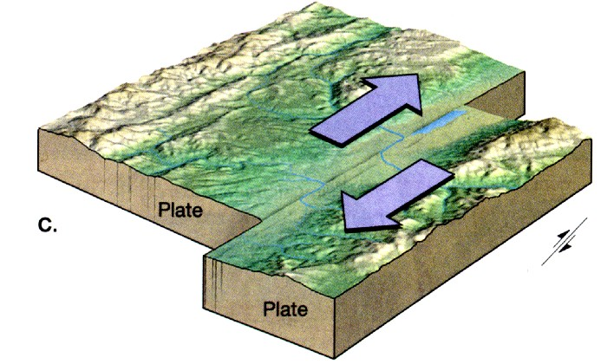
Boundary types
Transform boundaries
Two plate slide past each other
Lots of earthquakes

Slide 42
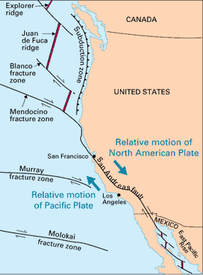
Transform boundaries

Slide 43
Boundary types
Divergent Boundaries/Spreading zone
Plates move away from each other.
Most are in the ocean
Cause mid ocean ridges
When on land the form a Rift Valley
Great Rift Valley in east Africa

Slide 44
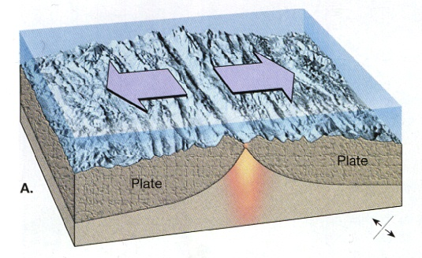
Divergent Boundaries

Slide 45
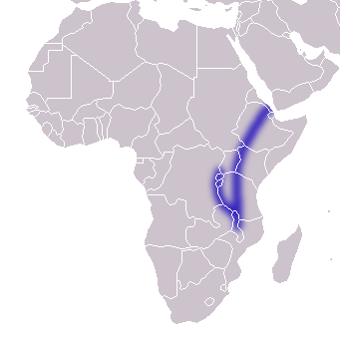
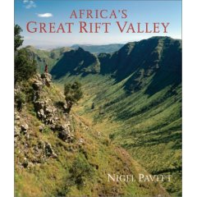
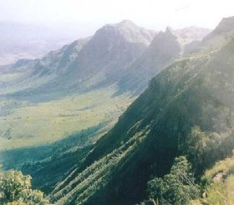
Divergent Boundaries

Slide 46
Convergent Boundaries/Subduction zone
Plates move toward each other.
More dense plate dives under less dense plate
Oceanic plates are more dense then continental plates
Subduction. – often causes rising magma, volcanoes
Oceanic Trench
Two continental plate collide – neither are dense enough to sink. What do they do instead?

Slide 47
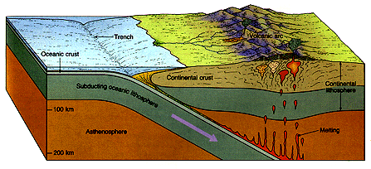

Slide 48
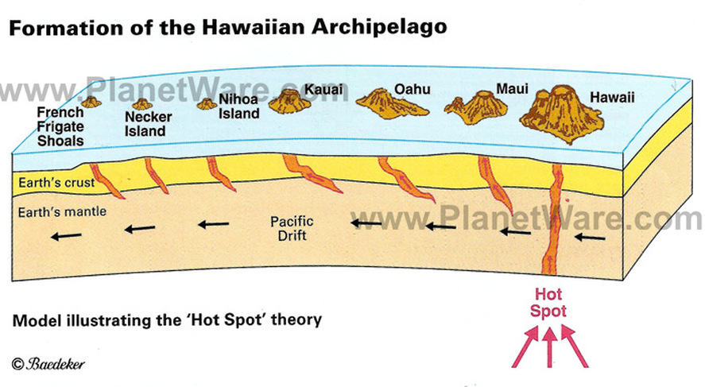
Volcanoes
Vent in the Earth’s surface
Plates move over a geologic hot spot
heat from the rising mantle plume melts the crust
Over time plates move away from hot spot and leaves islands..

Slide 49
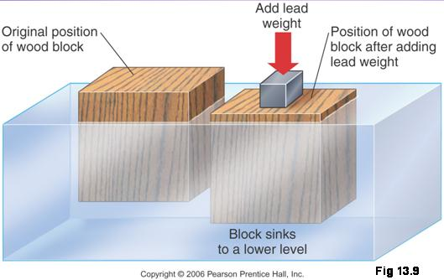
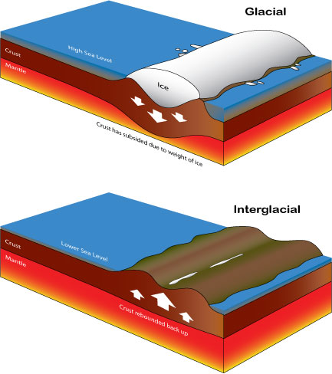
Isostasy
Mechanisms by which areas of the earth’s crust rise or subside until their masses are in balance on the mantle.

Slide 50
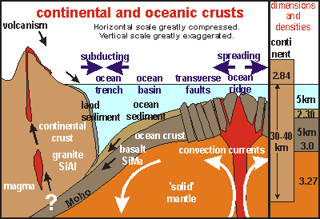
Isostasy controls the regional elevations of continents and ocean floors in accordance with the densities of their underlying rocks.

Slide 51
Key Questions today:
What is the theory of plate tectonics?
What are some environmental consequences of the tectonic cycle?
How do earthquakes and volcanoes occur?

